Slide 1
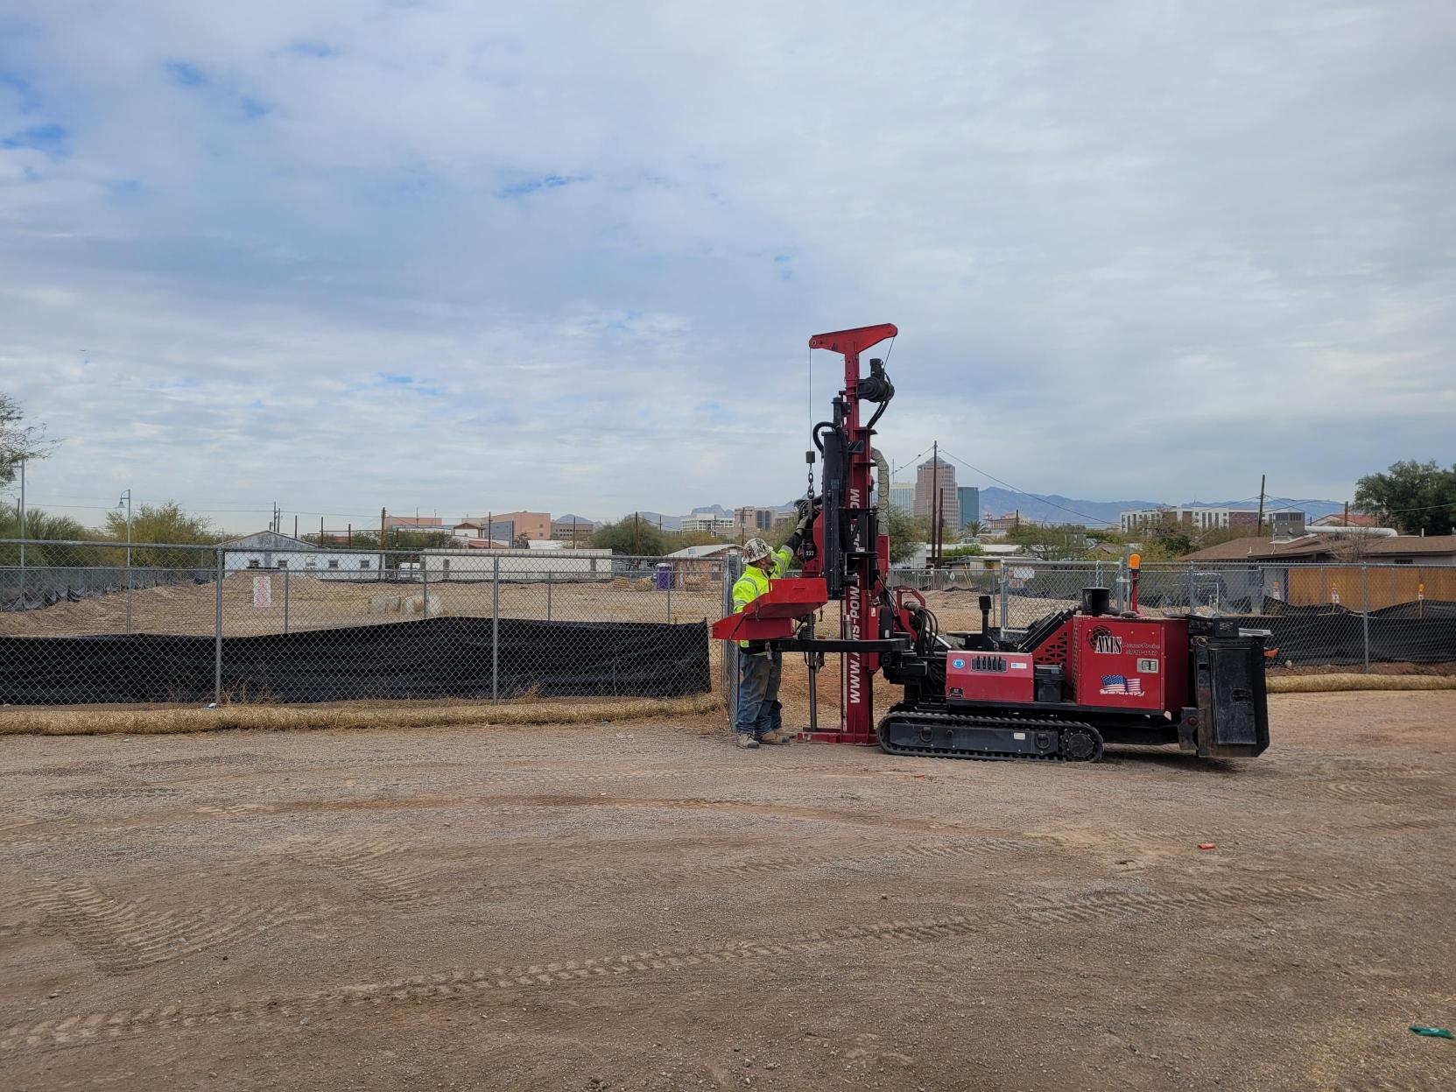
AUGUST 19, 2025
FORMER FLINT OIL PROPERTY
Site Cleanup
Update

Slide 2
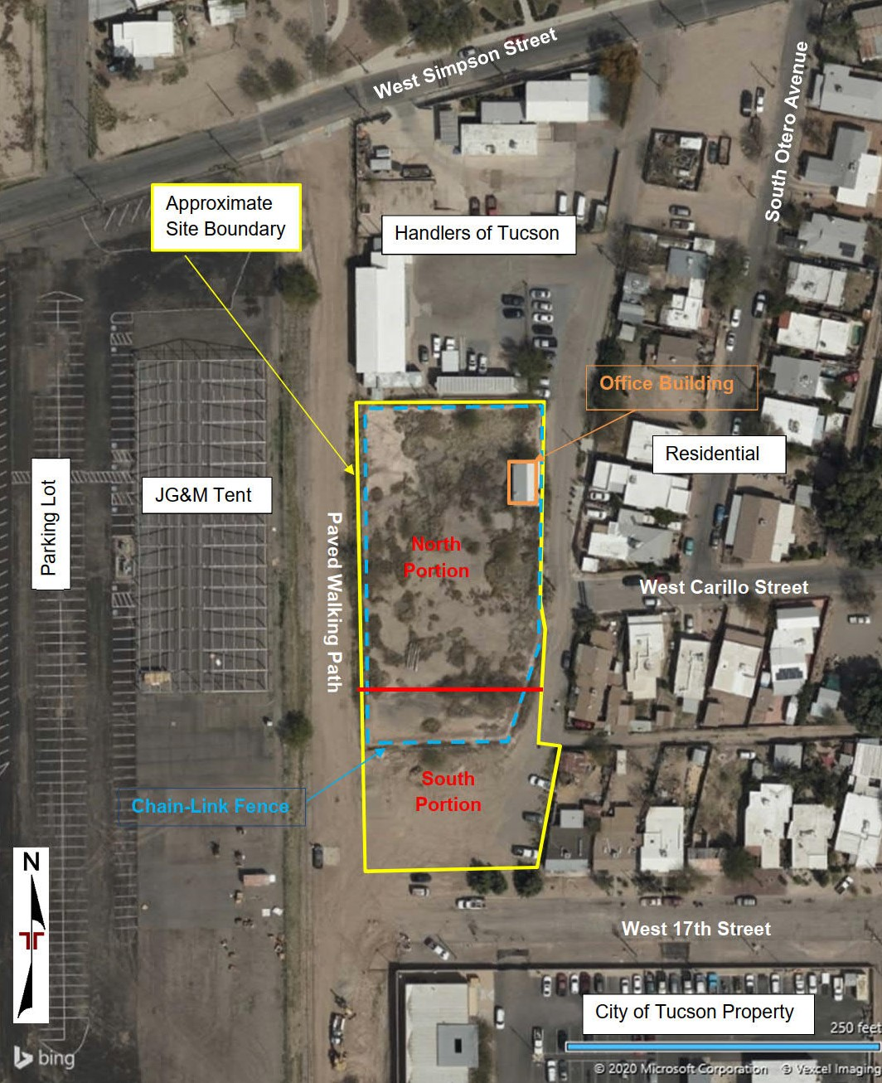
Overview
Background
  Site Location
  Site History
  Previous Site Assessments
Recent Site Assessments
  Alleyway Investigation
  Site Characterization Under the VRP
Remediation/ Site Closure
FORMER FLINT OIL PROPERTY

Slide 3
Site Location
Approximately 1.3 acres
575 square foot office building remaining on site
Vacant
FORMER FLINT OIL PROPERTY

Slide 4
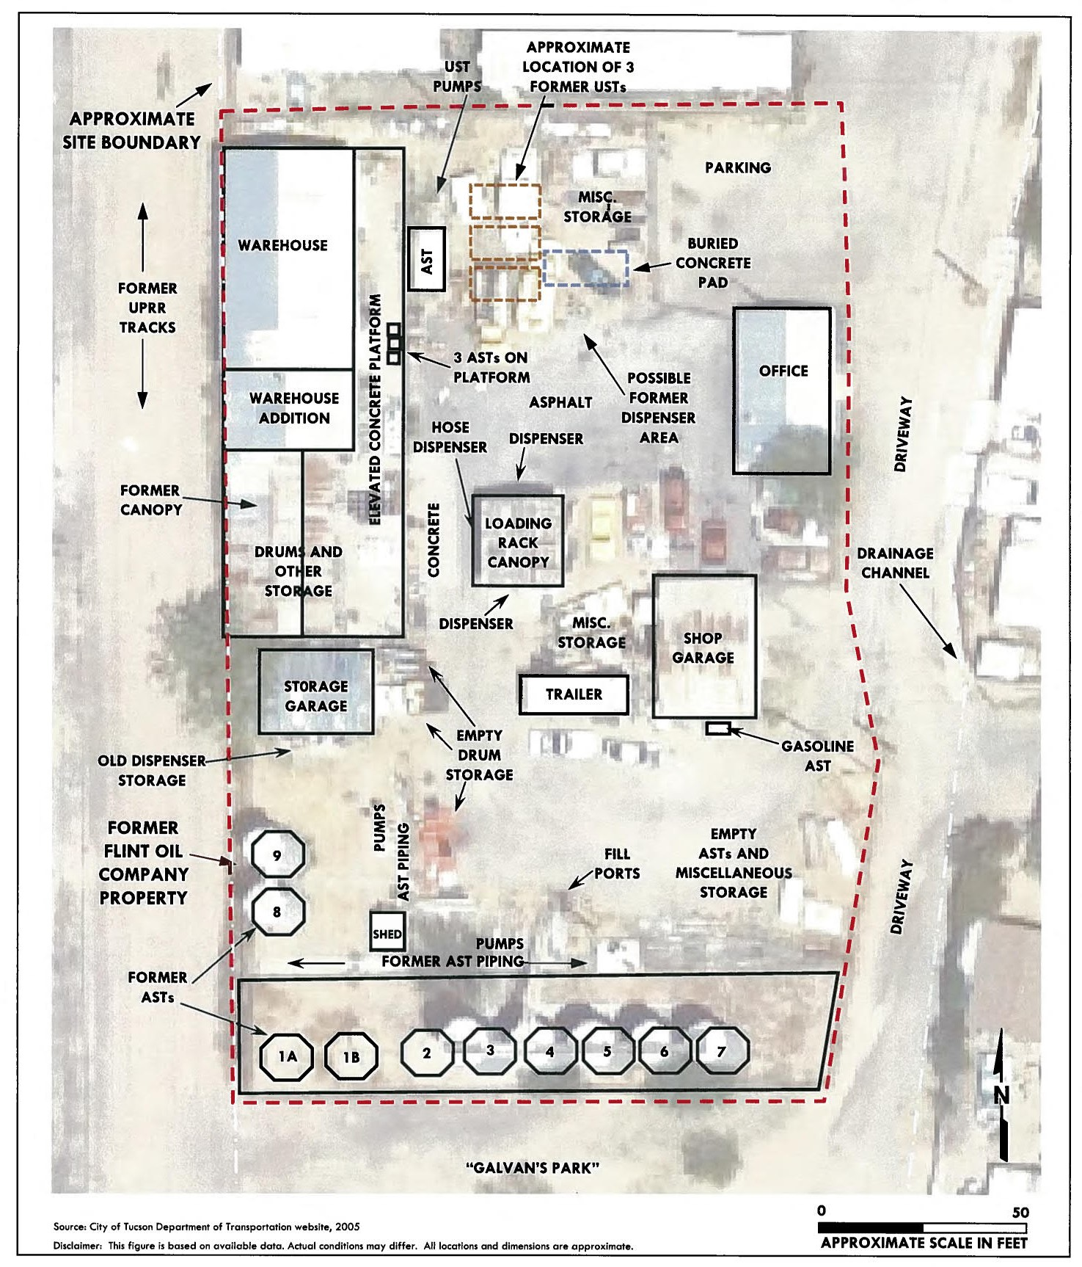
Site History
Deeded by City of Tucson to Southern Pacific Company (later Union Pacific Company) from 1879 to 2002
As early as 1925, multiple bulk distributors of oil, gasoline and diesel fuel, solvents, and other related products used on site
Historical ASTs ranging from 1,000 gallon capacity to 34,000 gallons
ASTs and bulk containers removed in 2007
Structures (office, shop garage, warehouse and canopy on elevated platform, and storage garage) removed in 2009
FORMER FLINT OIL PROPERTY

Slide 5
Previous Site Assessments
2006 to 2020 multiple projects assessing
  Soil contamination
  Potential for underground storage tanks
  Asbestos in on-site structures
  Lead-based paint in on-site structures
2024 – Alleyway soil investigation (Community Request)
2025 – Final site soil investigation
Next Steps: Site Remediation and Final Reporting
FORMER FLINT OIL PROPERTY
Notes:
Bold – new assessments conducted since the last public meeting

Slide 6
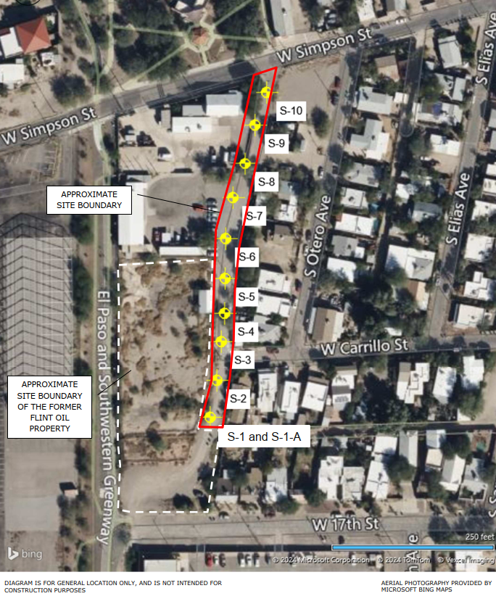
Alleyway Soil Investigation
During the previous public meeting, citizens were concerned that past industrial activities may have contributed to releases of contaminants in stormwater and fugitive dust to adjoining properties.
The alleyway was sampled to evaluate the presence of petroleum constituents and metals.
10 soil samples were collected from 5-10 inches below the ground surface.
FORMER FLINT OIL PROPERTY
Notes:
Several citizens expressed concern that past industrial activities at Flint Oil and other adjoining sites may have contributed to releases of contaminants in stormwater and fugitive dust to adjoining properties, and specifically requested that the alleyway be sampled.
Methods: 4 inch concrete cores, hand augers and trowels were used to collected the samples

Slide 7
Alleyway Soil Investigation
Results:
  Arsenic in S-9 exceeded cleanup standards.
  All other analytes were below cleanup standards.
Conclusion:
  No immediate action required since the soil is covered by pavement.
  A soil management plan should be used when the soil is disturbed and/or transported.
FORMER FLINT OIL PROPERTY
Notes:
S-9 = 41.8 mg/kg
Residential and non-residential SRLs =10 mg/kg
GLP = 290 mg/kg
Mean (AS concentrations) = 7.35, UCL = 14.4
According to ADEQ, soils with arsenic levels above the SRL that are not transported offsite do not require that a property owner comply with the SRLs and the SRLs would be advisory. Therefore, if soils generated during ground disturbing activities require export offsite for disposal, additional waste characterization/waste profile sampling and analysis of the material may be required for landfill acceptance.
Based on the current use of the land as a paved alleyway, no further investigation of the
site is recommended at this time. If subsurface features or impacted soils are encountered
during construction or excavation, the soils may require management and/or proper off-site
disposal. Terracon should be contacted for guidance, to assess the situation and recommend
additional action if appropriate.
Workers performing ground disturbing activities within areas of the elevated arsenic
concentrations should be notified of the presence of metals in shallow subsurface soils and
compliance with OSHA regulations should be followed for worker protection purposes. The
client may consider having a Soil Management Plan (SMP) prepared to provide guidance on
the proper handling and disposal of soils that may contain metals.

Slide 8
Final Site Soil Investigation
Conducted under State Voluntary Remediation Program
Project Plans were available for review and public comment
State-reviewed and approved Project Plans after incorporation of public comments
Contaminants in soil were compared to residential cleanup standards
FORMER FLINT OIL PROPERTY
Notes:
(Work plan comment) inquired if groundwater would be tested.
Based on the soil analytical data, there were no exceedances of soil-to-groundwater soil cleanup standards that would suggest there is path for migration of contaminants from the soil to groundwater. As a result, the City has elected not to further investigate groundwater under the VRP.

Slide 9
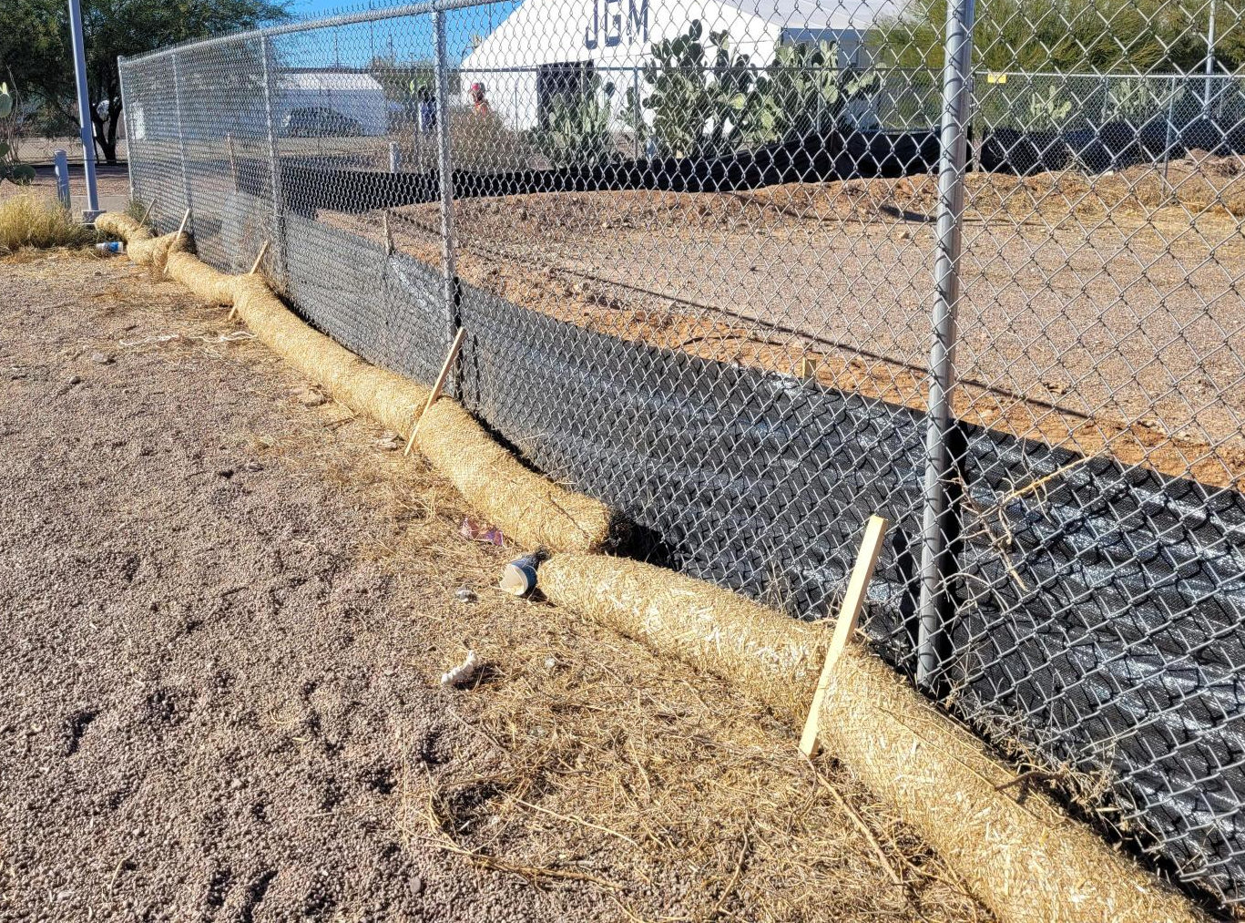
Permitting
Stormwater Pollution Prevention Plan – Arizona Department of Environmental Quality
Dust Control – Pima County Department of Environmental Quality
Perimeter Air Monitoring
Vibration Monitoring
FORMER FLINT OIL PROPERTY

Slide 10
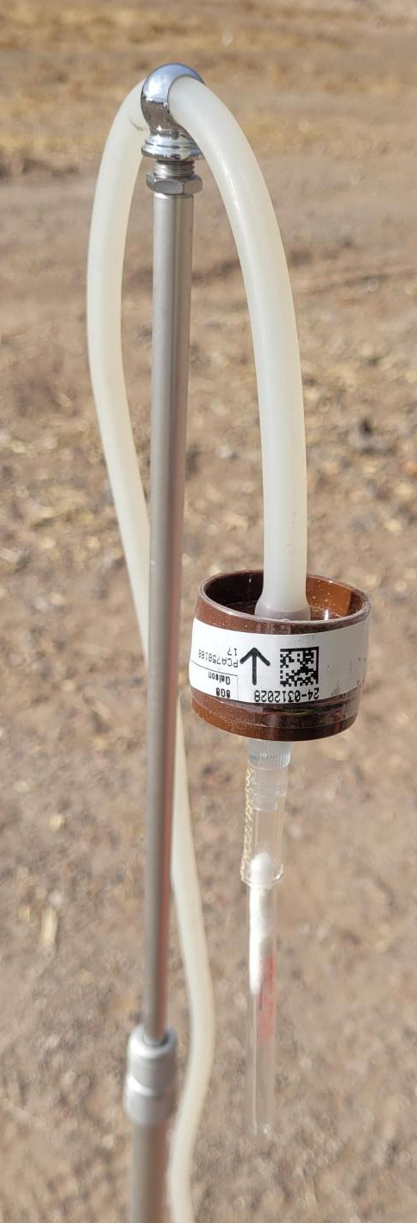
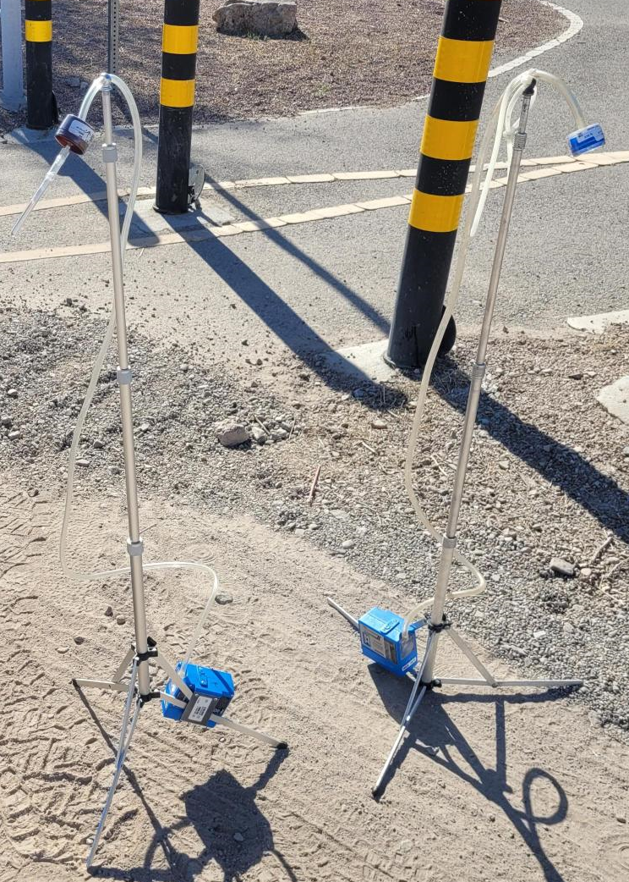
Perimeter Air Monitoring
Total dust sample collected and analyzed for metals (arsenic, lead) and petroleum constituent (benzo(a)pyrene)
One upwind and two downwind locations each day.
Samples were collected during the first three days of ground disturbing activities.
Since all samples were non-detect, sampling frequency was reduced to every third day.
FORMER FLINT OIL PROPERTY

Slide 11
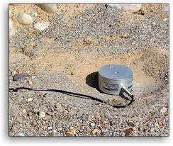
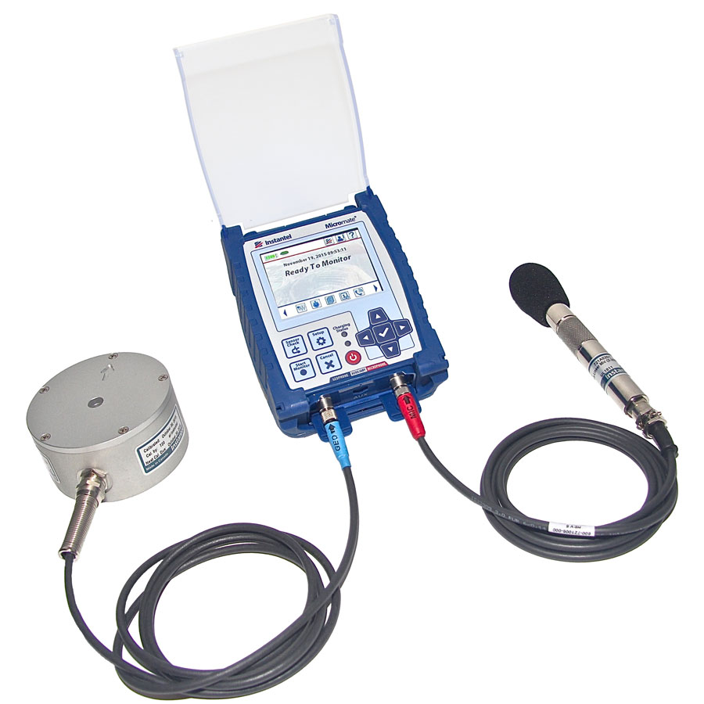
Vibration Monitoring
Terracon monitored ground vibrations during drilling activities
When an exceedance was observed, the activities were adjusted to reduce the vibration.
Overall, reasonable means were made to fairly and accurately document the conditions at the site and minimize the vibration disturbance to the surrounding structures.
FORMER FLINT OIL PROPERTY

Slide 12
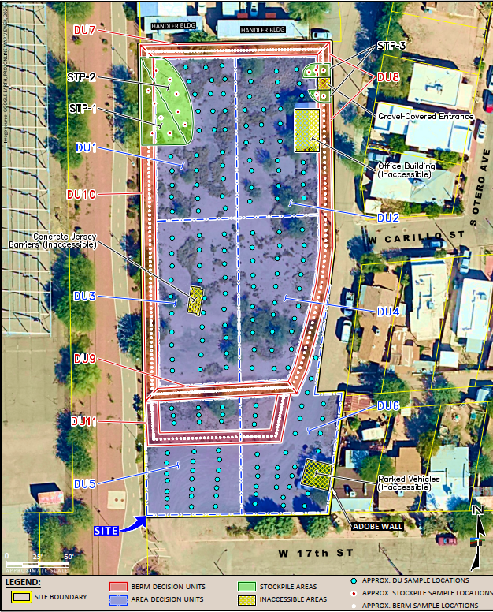
Soil Sampling
6 interior area decision units
  30-point composite sample collected from 3 depths
    Surface to 8 inches below ground surface (bgs)
    8 inches to 2 feet bgs
    2 feet to 4 feet bgs
5 berm area decision units
  60-point composite sample collected from 1 depth
    ½ of the height of the berm (~ 18 inches below the top of the berm)
3 stockpile samples
  5-point composite samples
  Collection depth ranged from 1 to 2 feet below the top of the stockpile
FORMER FLINT OIL PROPERTY
Notes:
Site was divided into three types of sample areas

Slide 13
Soil Sampling
Results
  Lead above cleanup levels in DU3 down to 8 inches
  No contaminants above clean up levels in berms and stockpiles
Recommendations
  Excavate DU3 to 2 feet
  Berms and stockpiles will be used as backfill
  Additional clean backfill will be brought in
DU3
FORMER FLINT OIL PROPERTY
Notes:
Arsenic exceeded screening levels and standards in DU2
In the near surface level (0-8 inches below ground surface)
But within naturally occurring levels

Slide 14
Remediation
Approximately 2 weeks of field work
Dust Control
Stormwater Pollution Prevention Plan
  Update the silt fencing and wattles
Vibration Monitoring
Backfill will be tested for
  Petroleum products (PAHs, VOCs) Metals, and PCBs
  Soil properties (particle size, plasticity, compaction properties)
DU3
FORMER FLINT OIL PROPERTY

Slide 15
Schedule
August 19, 2025 – Public Meeting to communicate findings
Next Steps
  Remediation
  Site Remediation Report to City
  Site Remediation Report to ADEQ
  No Further Action Determination Issued by ADEQ
FORMER FLINT OIL PROPERTY

Slide 16
Questions and Contacts
Ursula Ginster, City of Tucson
Ursula.Ginster@tucsonaz.gov
(520) 330-7917
Annie McCawley, Terracon
Annie.McCawley@terracon.com
(520) 798-4823
Jennifer Widlowski, ADEQ
Widlowski.Jennifer@azdeq.gov
(602) 771-2256
FORMER FLINT OIL PROPERTY

