Slide 1
Changing Hearts, Minds, and Communities
WholisticTransformationTucson.org

Slide 3
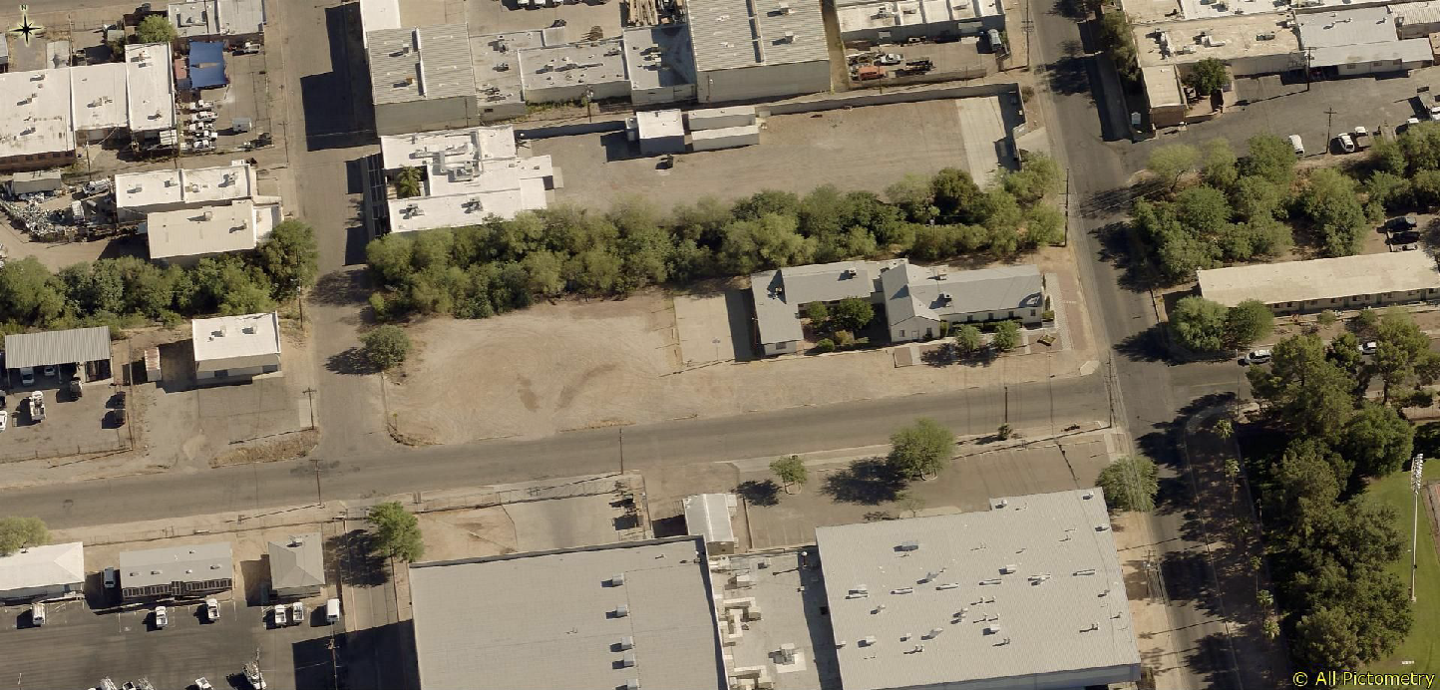
The neighborhood before we started acquiring shipping containers
Bethel Community Baptist Church
U of A Soccer, Track & Field Stadium

Slide 4
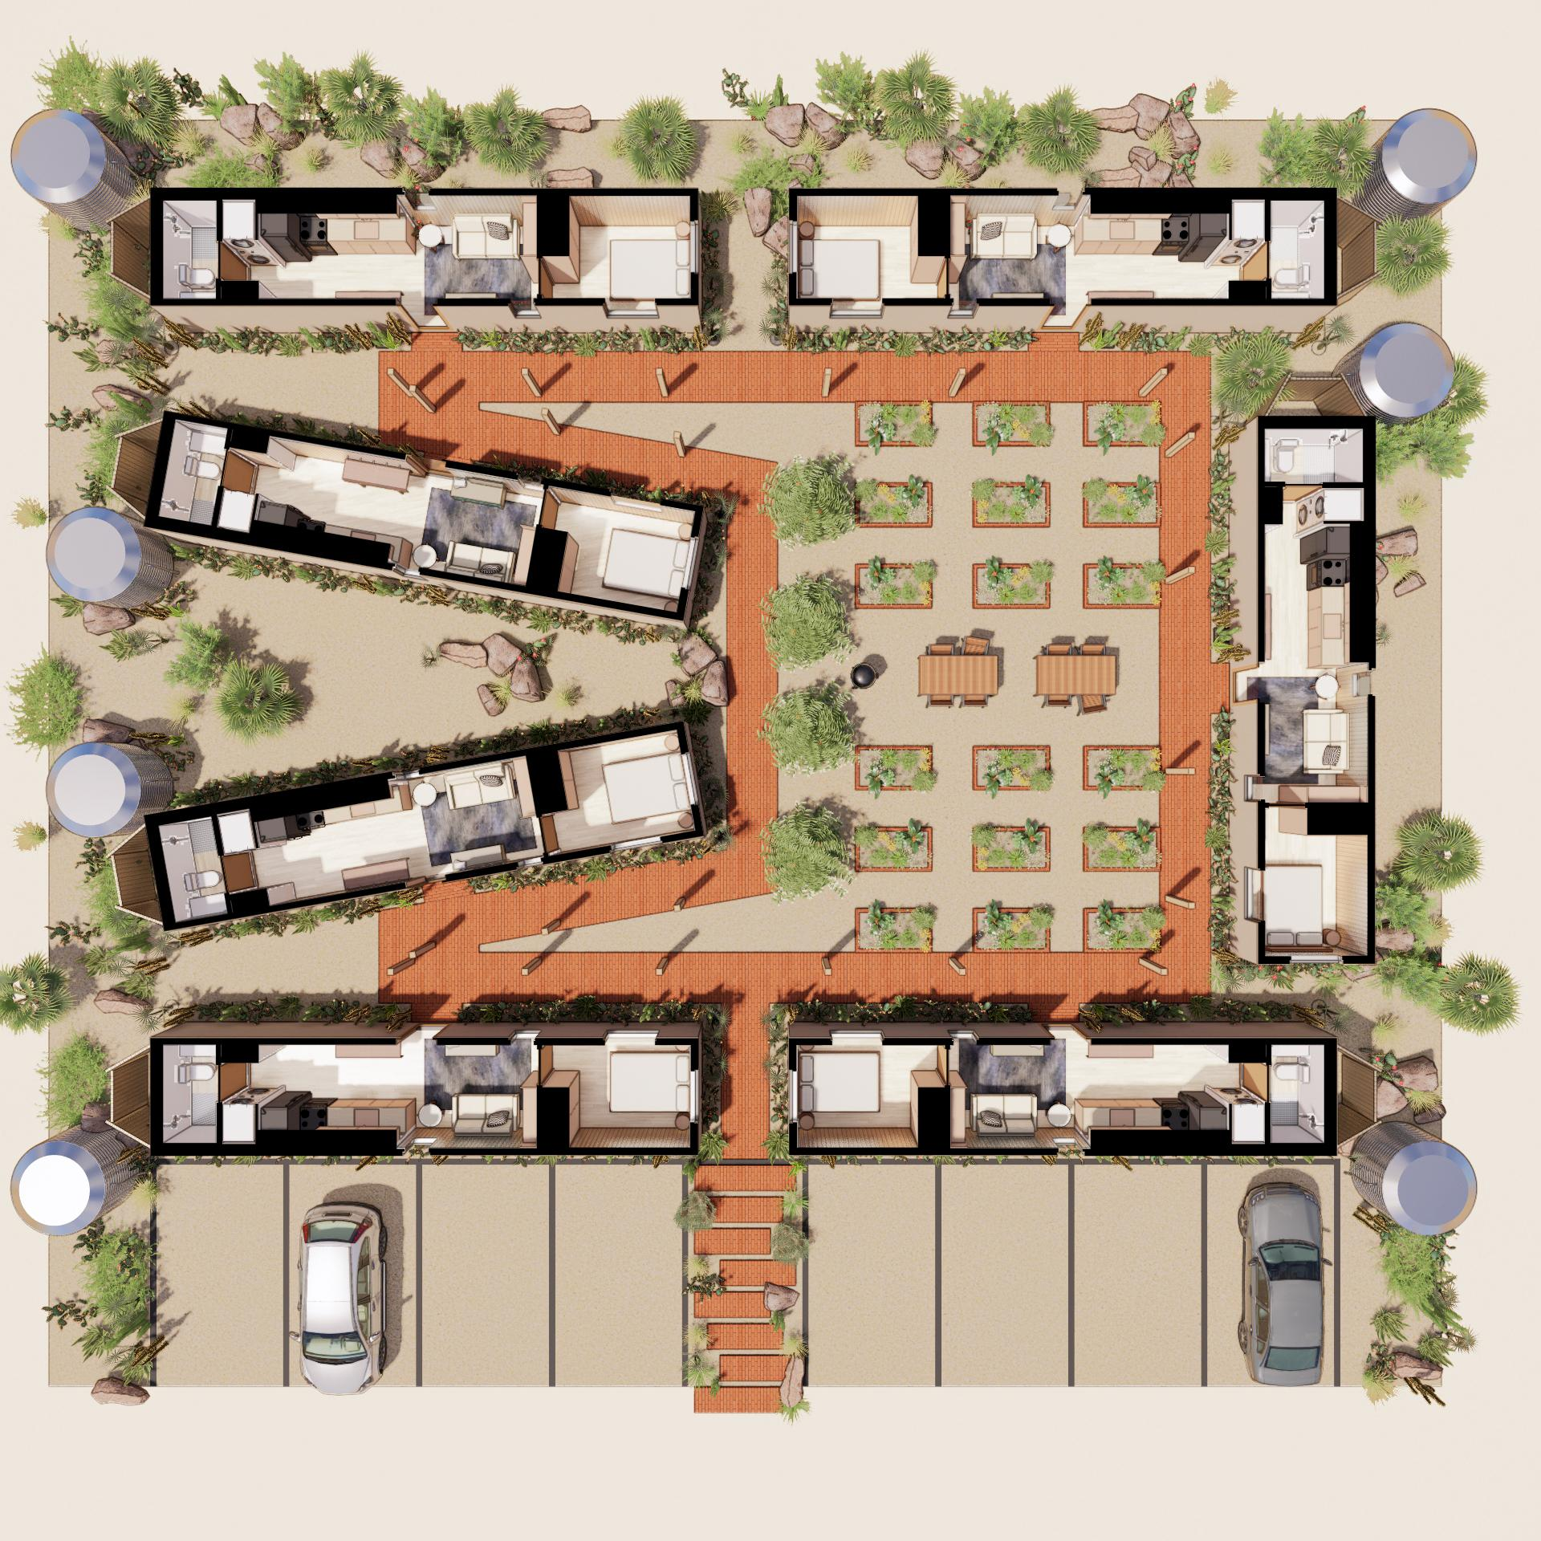
Preventative work stops bad outcomes, rather than attending to a crisis

Slide 5
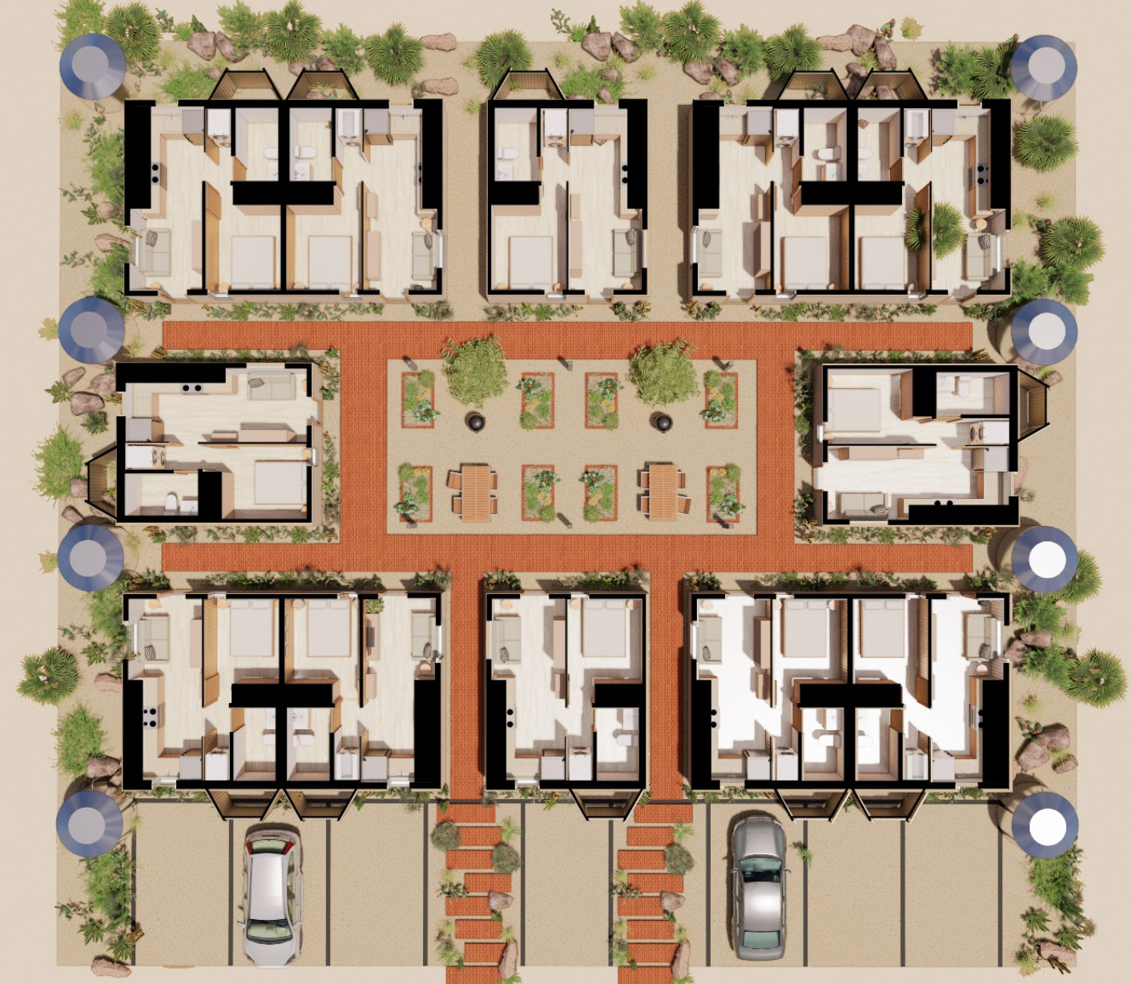
12-home Site Plan

Slide 6
Shocking Static Statistics
• 20% aging out will instantly become homeless
• 50% will be unemployed by age 24
• 60% of young men serve prison time
• 70% of young women will be pregnant by age 21

Slide 7
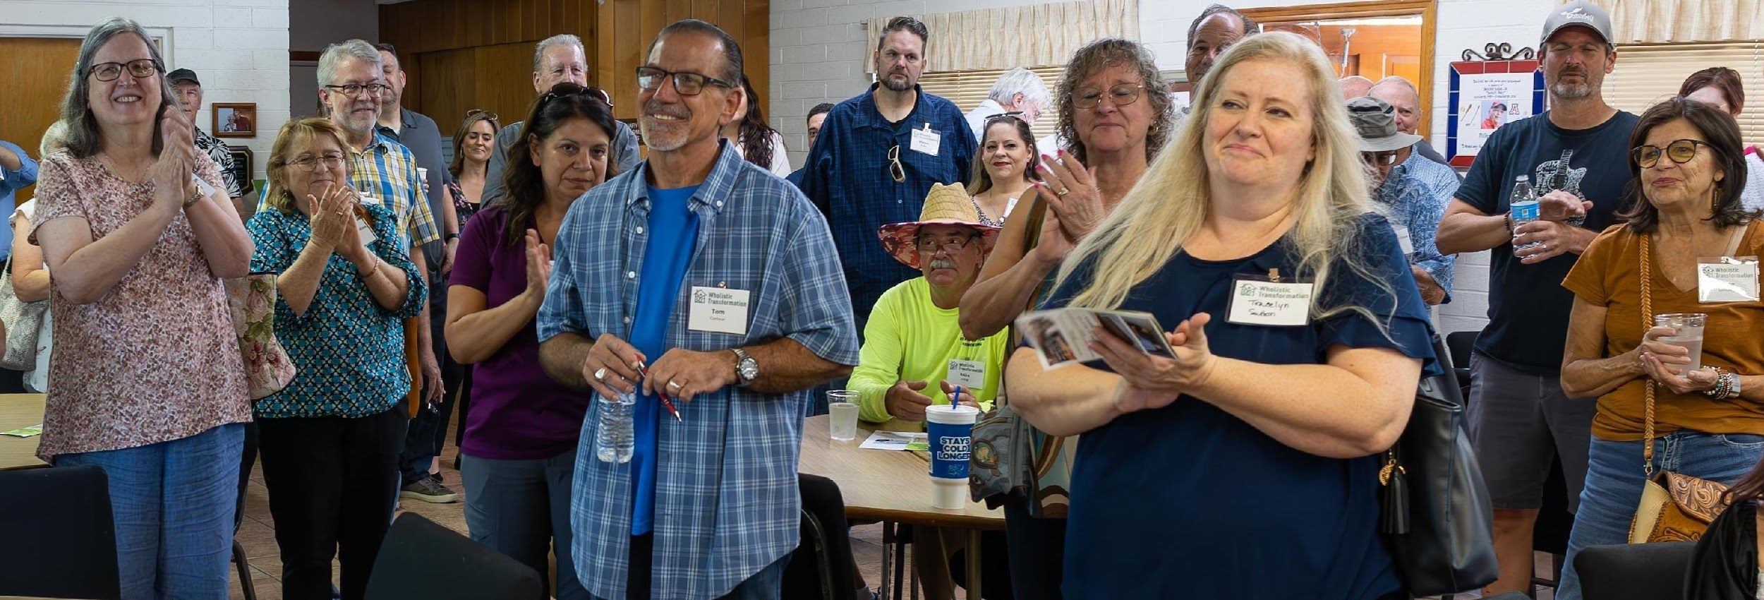
Wholistic Transformation
Changing Hearts, Minds, and Communities
Community Support

Slide 8
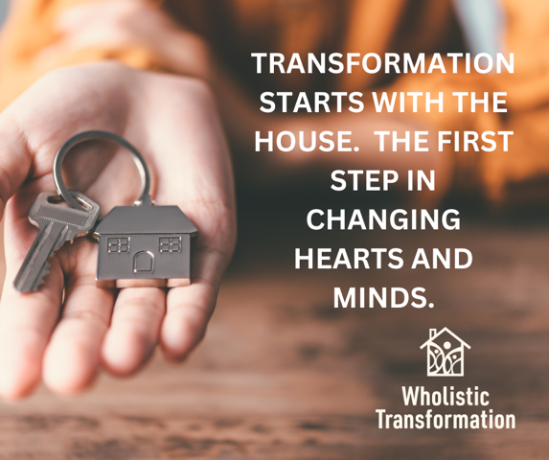

Slide 9
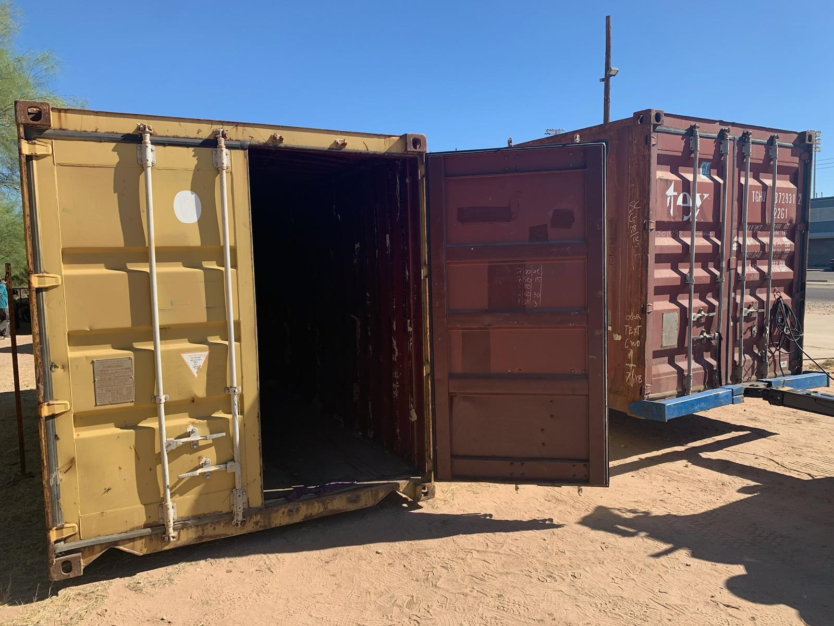
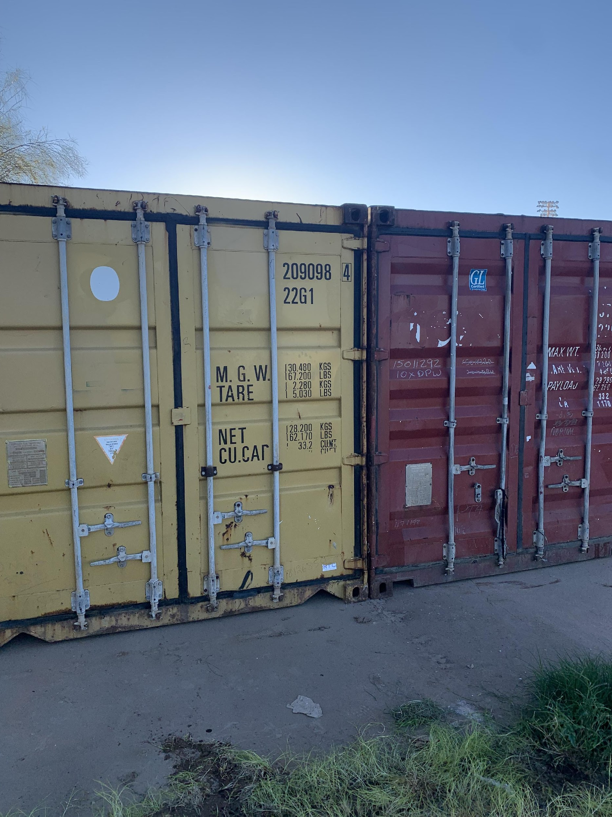
The two 20-foot containers we purchased from the state of Arizona after they were removed them from the USA-Mexico border wall
Delivery
Pushed together

Slide 10
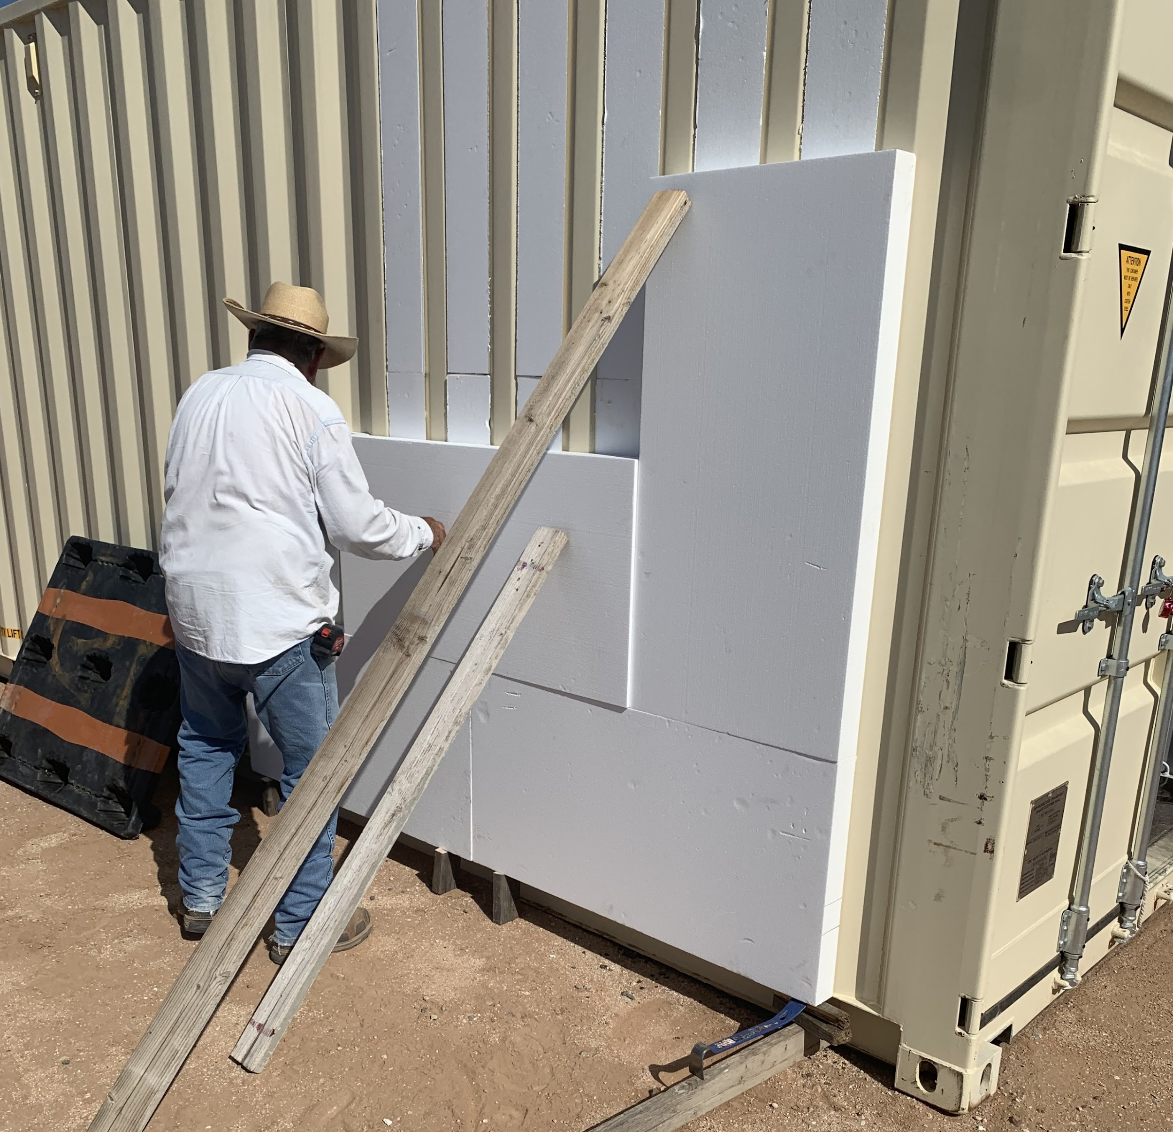
Demonstration of the exterior insulation
(we call “outsulation”)
we plan to use on all our shipping containers.

Slide 11
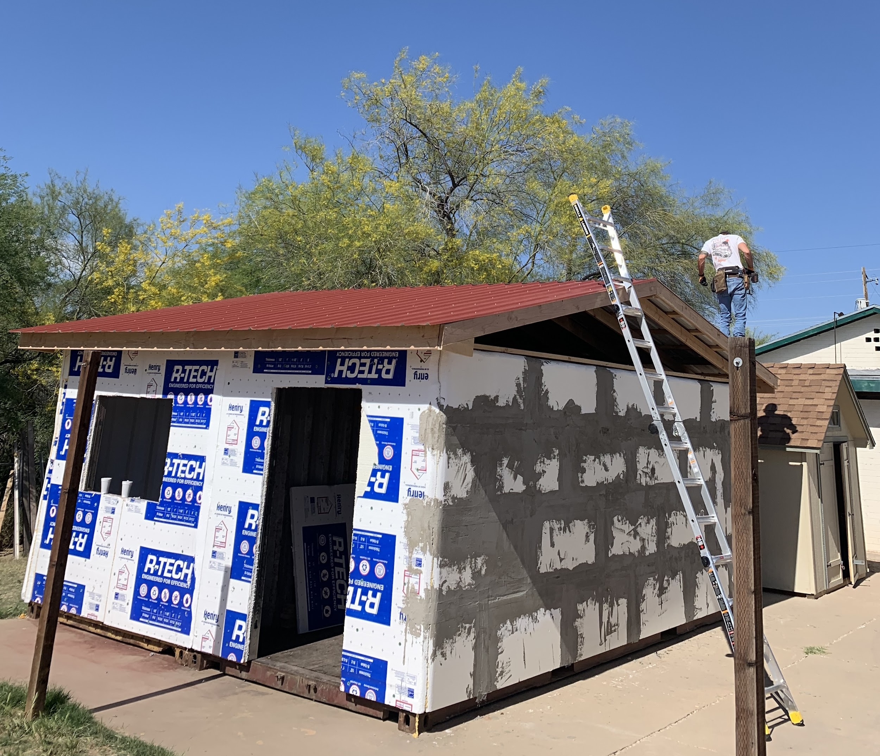
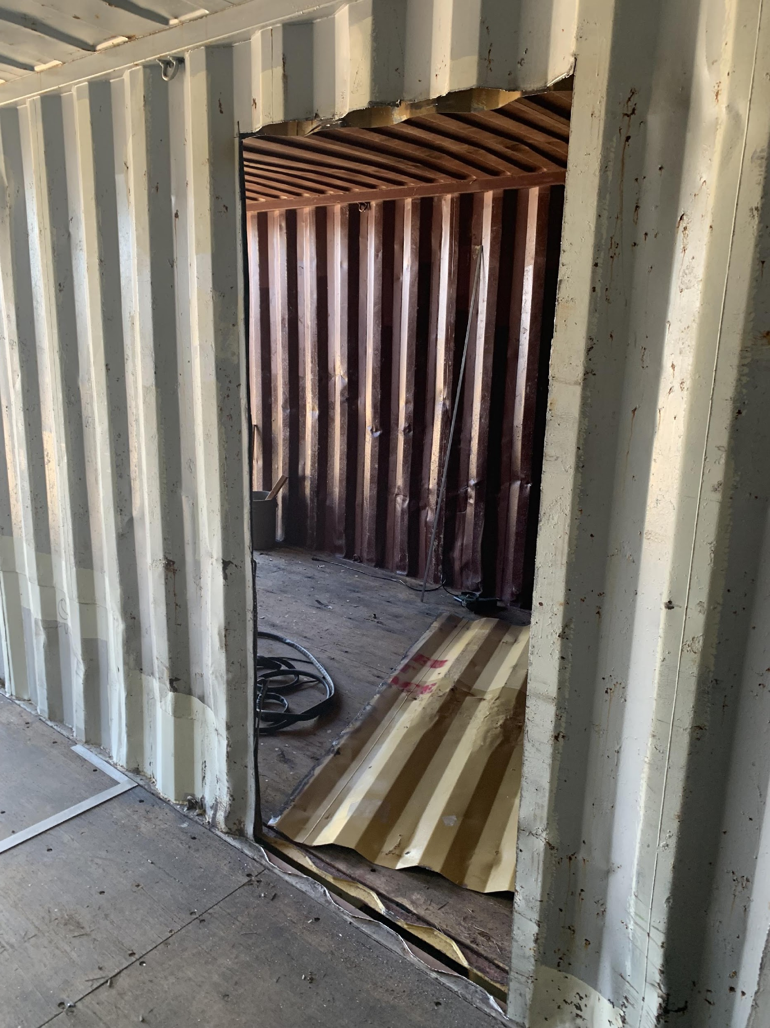
Barrier to Bedroom
now combined into our future first model home
Roof!!!!!
Door
Opening

Slide 12
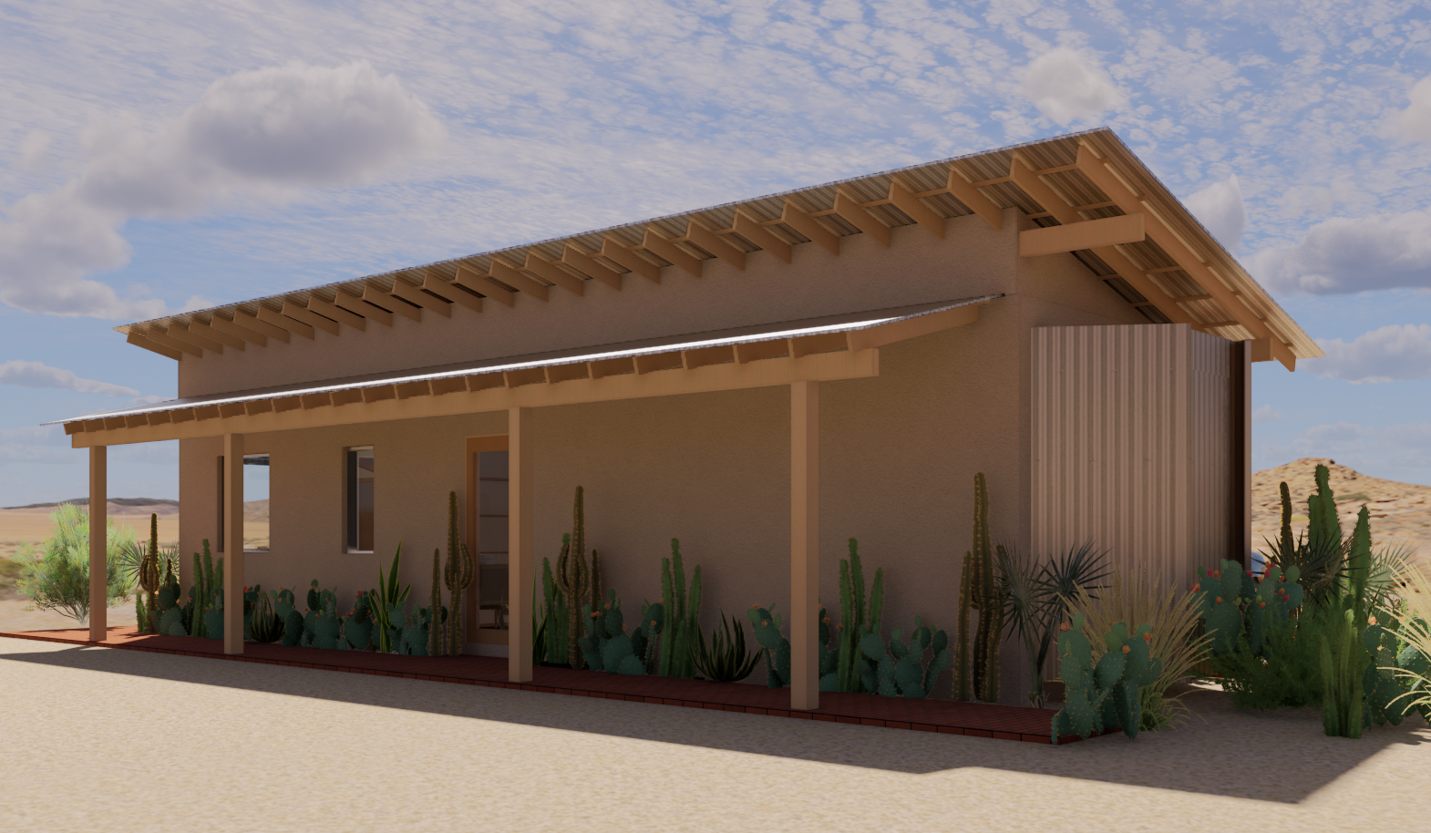
Rendering of a finished one-bedroom 40-foot home

Slide 13
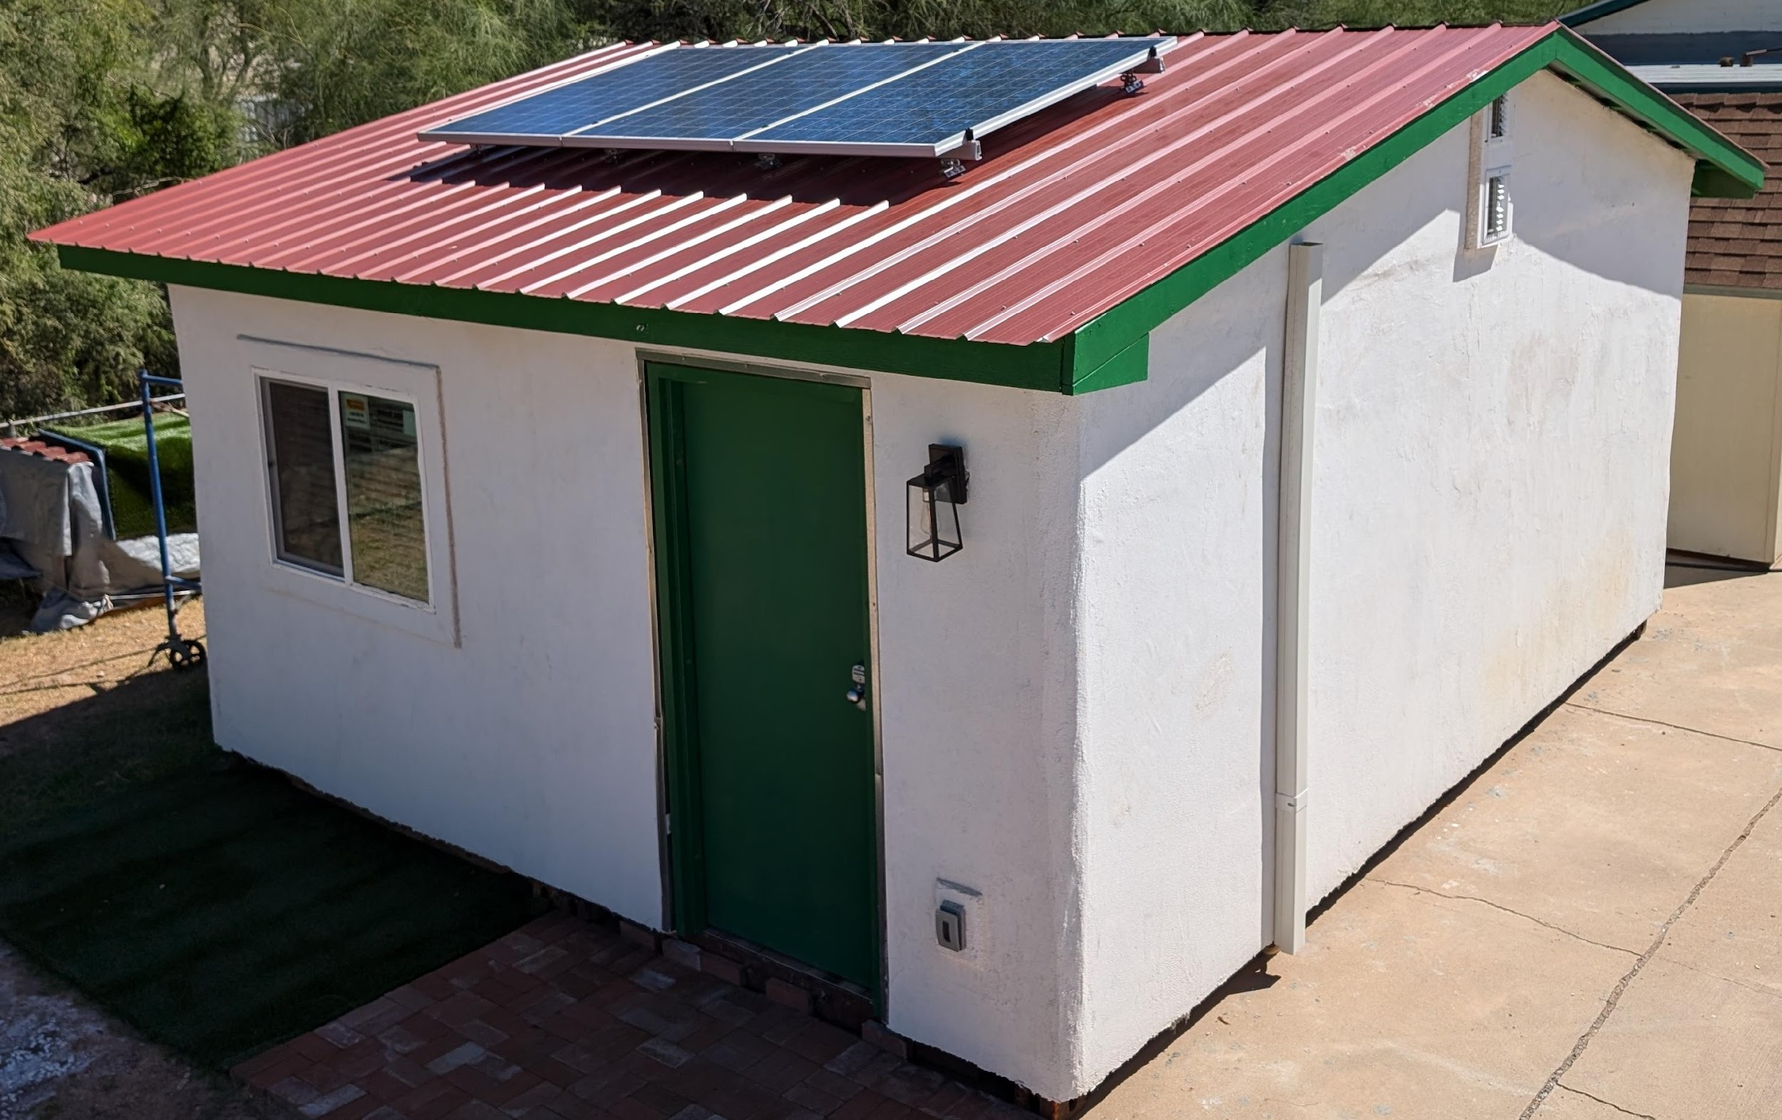
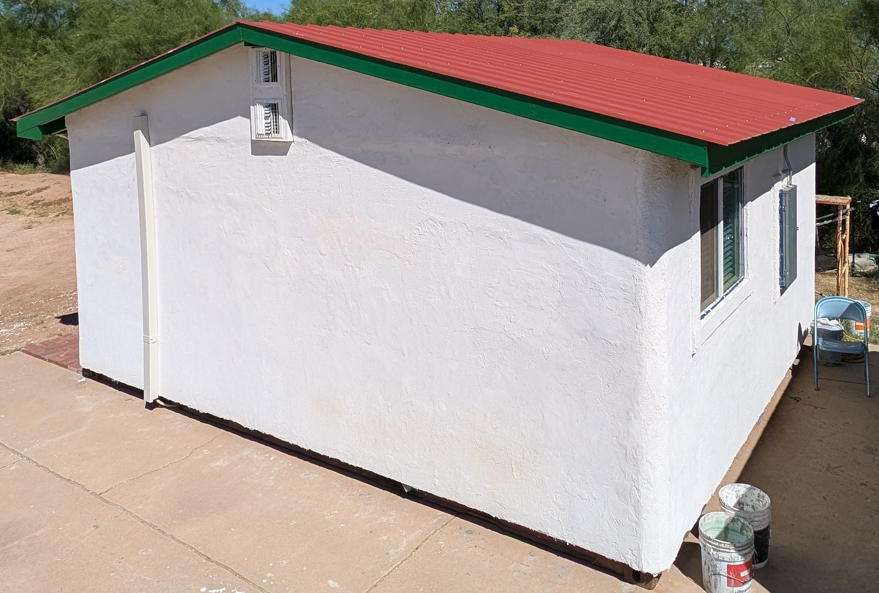
Our Model Home & Future Hope

Slide 14
Solar Panels on our Model Home

Slide 15
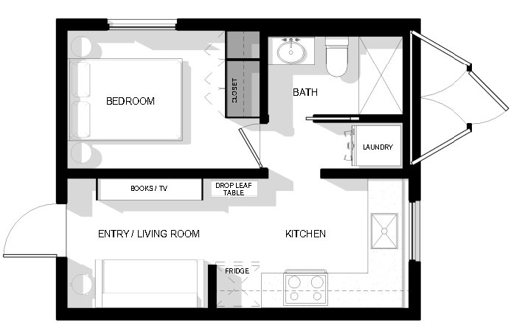
Unit Plan for combining two 20-foot containers

Slide 16
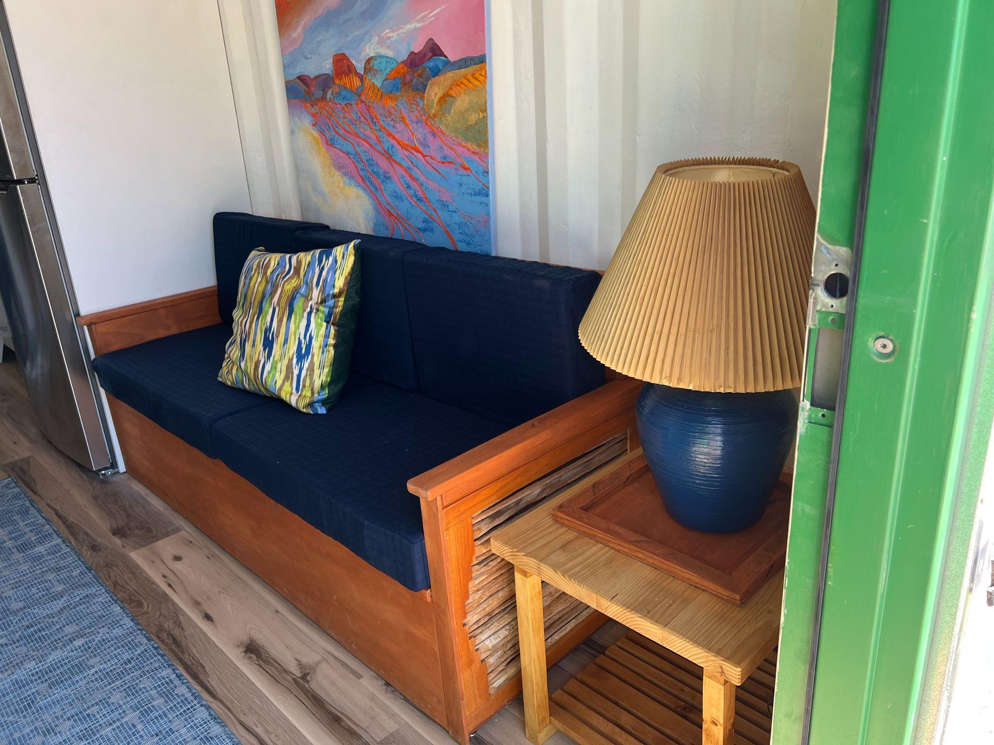
Custom made couch with storage and a custom made end table

Slide 17
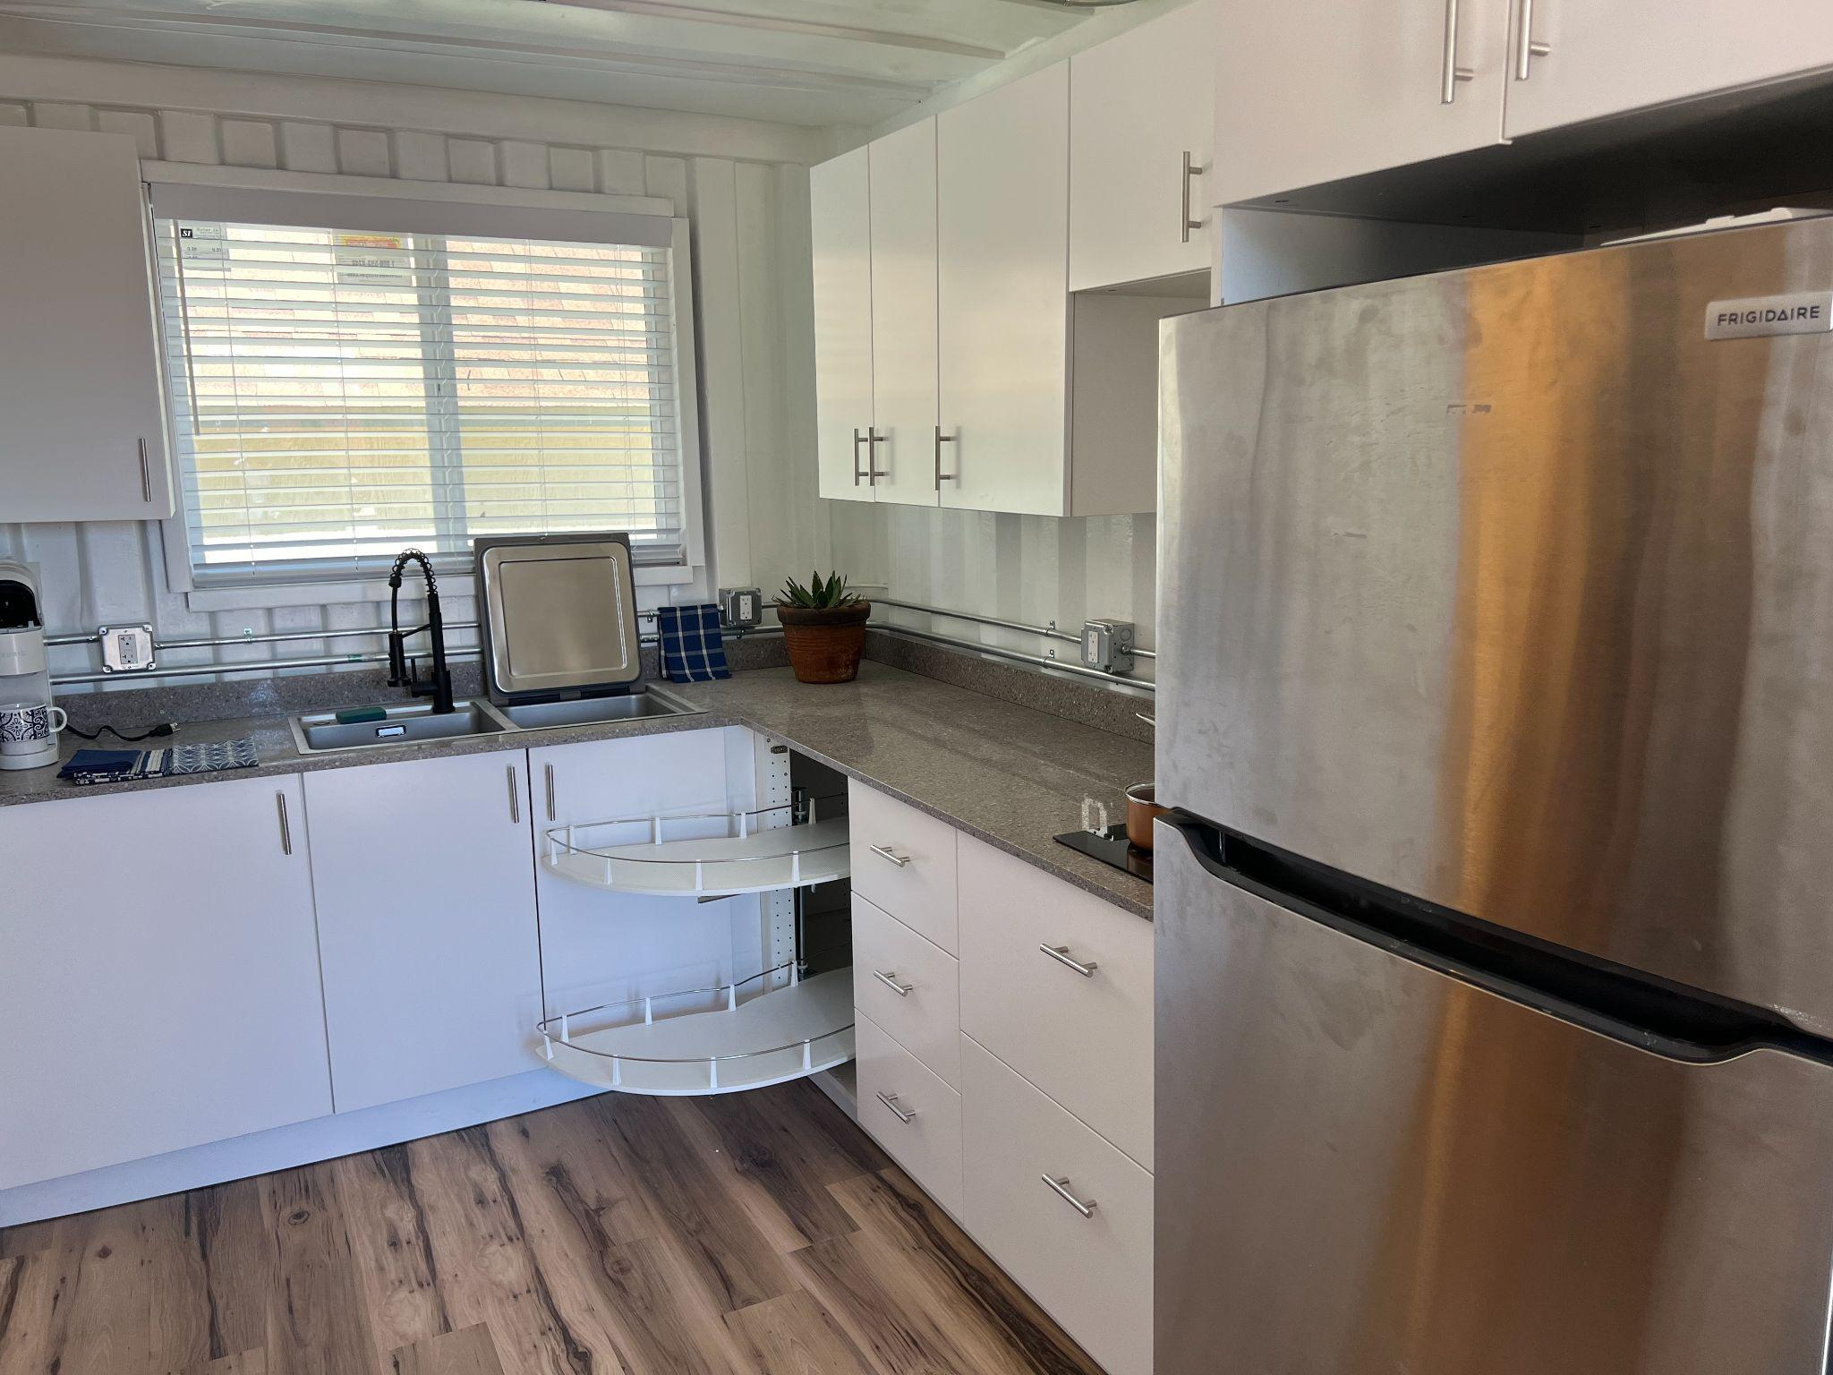
Kitchen

Slide 18
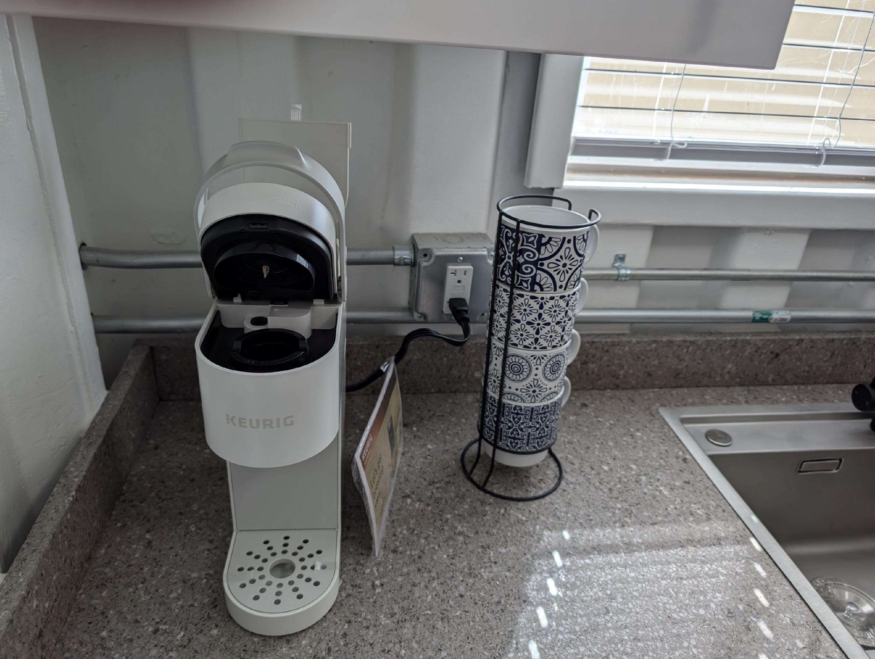
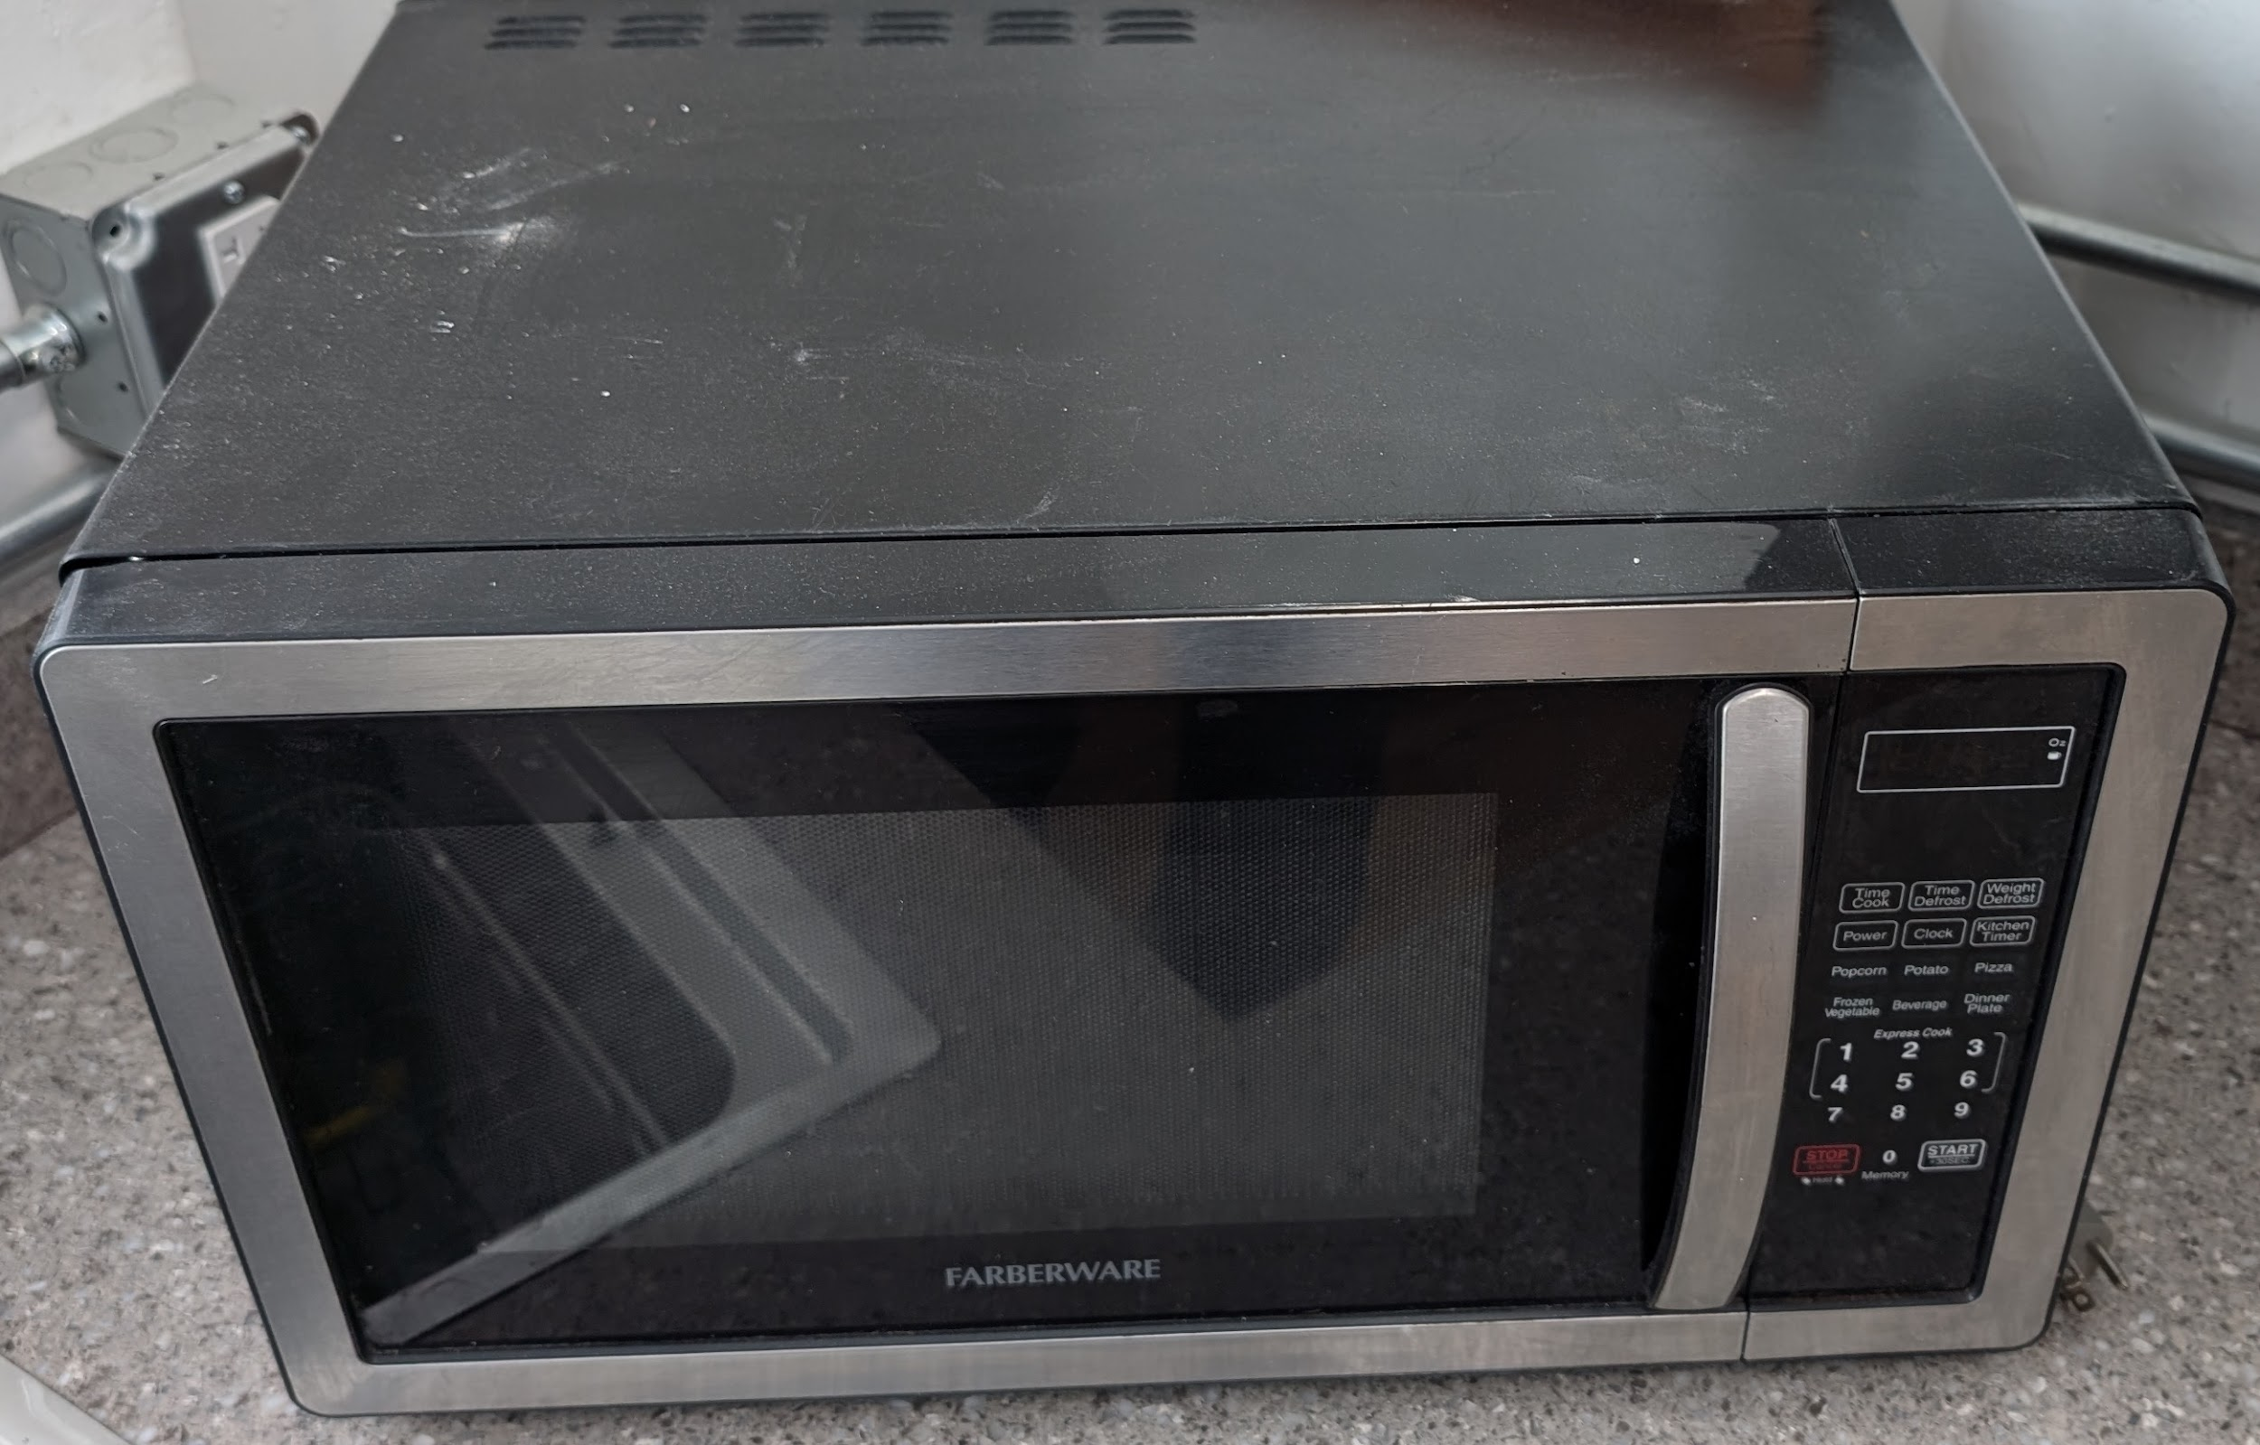
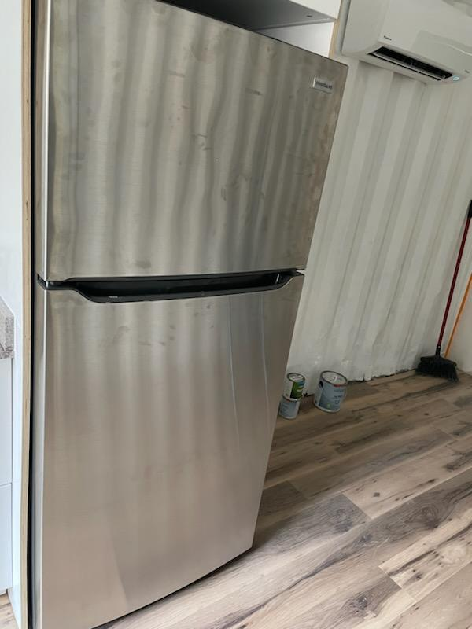
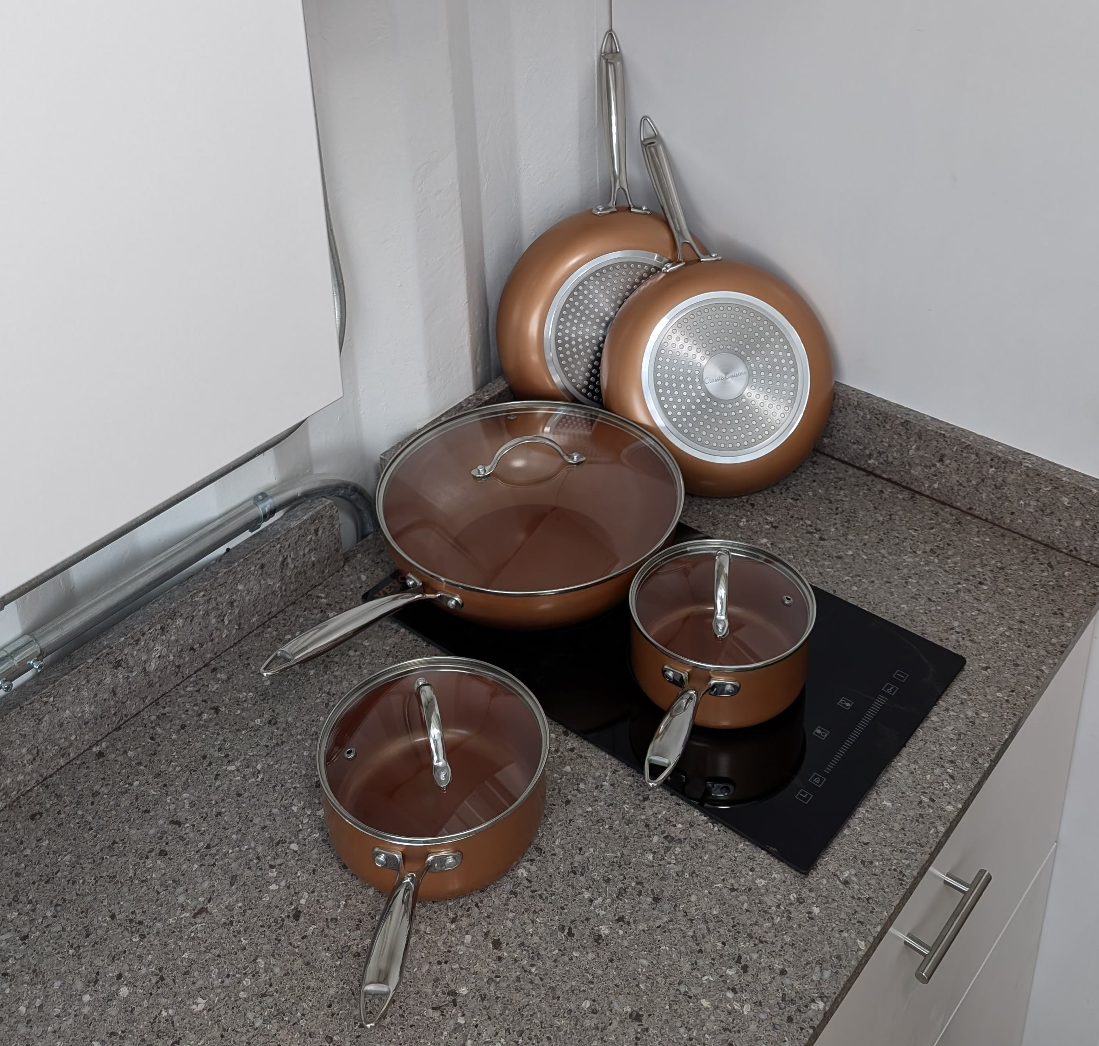
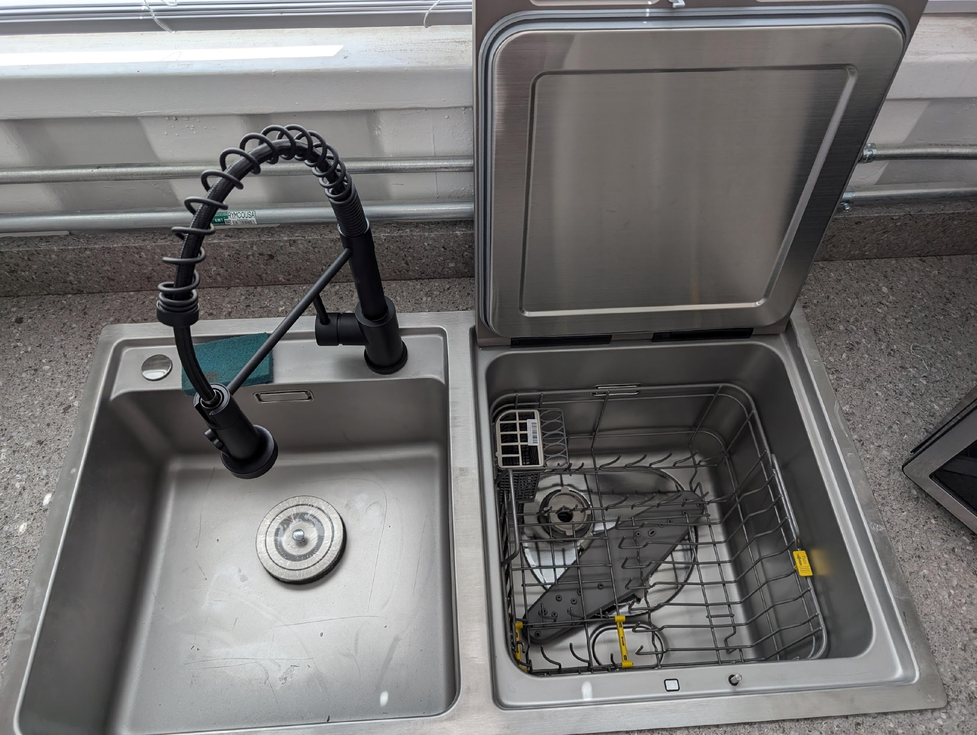
Model Home Kitchen!!!!

Slide 19
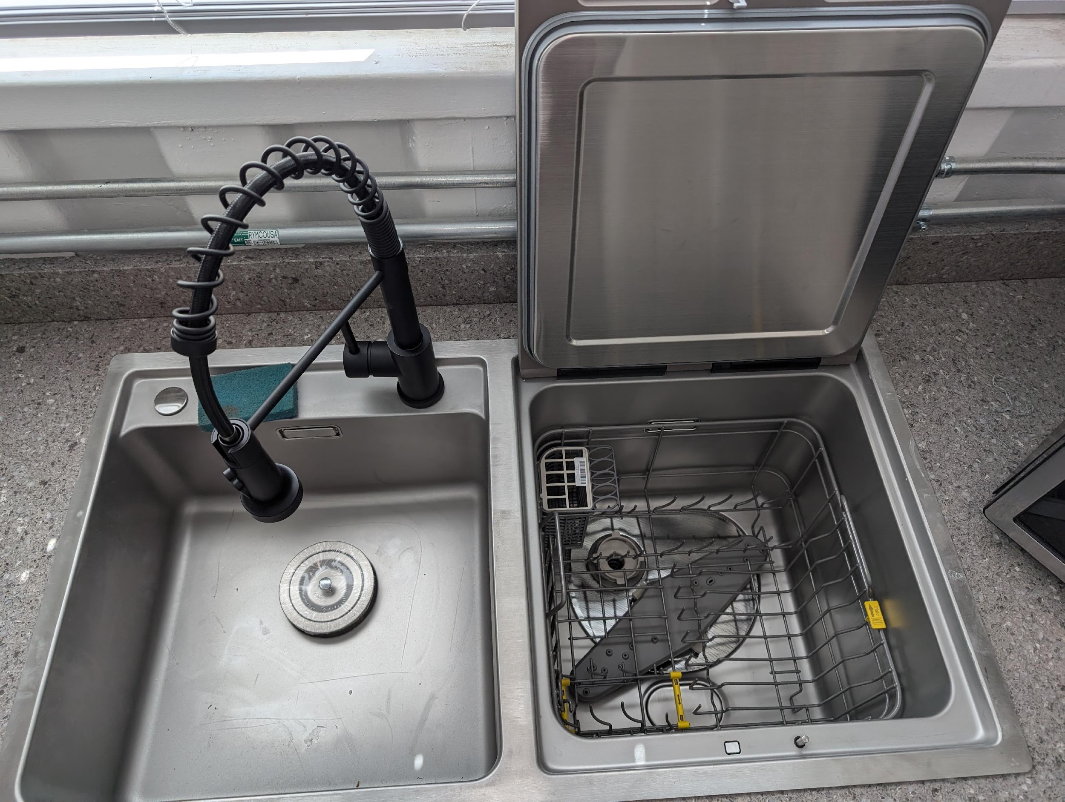
Dishwasher in the sink!

Slide 20
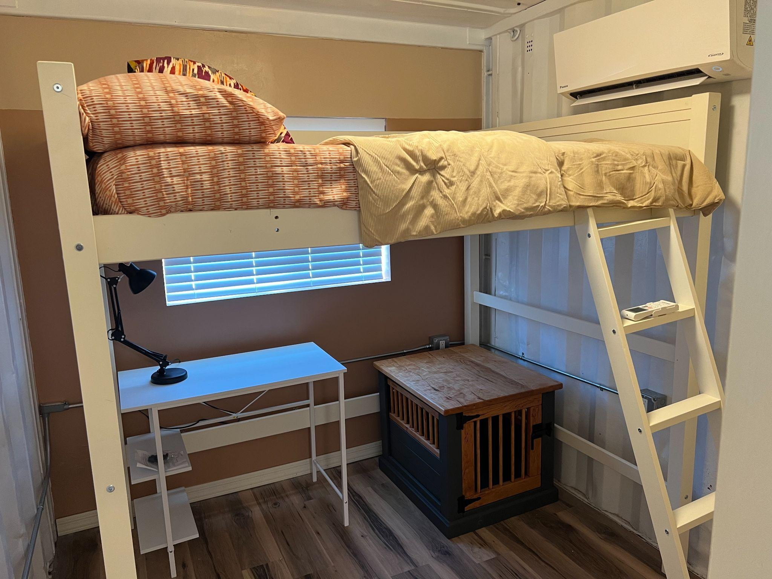
Loft bed frame with a large under space below for a desk in our Model Home

Slide 21
The Navigator
A navigator, residing on site. Someone willing to live life with young adults. They help create an environment where relationships and community are built. They create connections with other nonprofits to provide necessary resources that lead to changed hearts and minds.

Slide 22
Call to Action
Recommend the right Navigator
Volunteer your time and talents
Support us financially
Attend an Open House:
Sep 24 - 5:00 - 7:00 pm
Sep 27 - 8:00 - 10:00 am
Sep 28 - 9:30 - 11:30 am

Slide 24
Changing Hearts, Minds, and Communities
WholisticTransformationTucson.org

