Slide 1
High Utility Costs for Mobile Home Park Residents:
Issues and Remedies
December 5, 2024
Raye Winch

Slide 2
Mobile Home Parks and Manufactured Housing Communities
Manufactured Housing is an important part of affordable housing equation with over 1000 mobile home parks and manufactured housing communities in the State of Arizona. There are approximately 50,000 units of manufactured housing in Pima County.
For this presentation, I will focus on Manufactured Housing and Mobile Homes where people own their home but rent the land on which it sits (including people in “rent-to-own” agreements who are paying a mortgage on a home and renting the lot).
This prevalent form of housing in the City of Tucson is sometimes overlooked by much housing work.

Slide 3
Multiple forms of precarity
People are at risk of losing their home in the event of an eviction
People are less able to move if rent is increased
There is less regulation of utility charges
Vulnerability of the homes themselves with temperature control
Vulnerability of residents, who are disproportionately seniors, people with low incomes, and people who are non-US Citizens who may not qualify for support services

Slide 4
Multiple forms of precarity
People are at risk of losing their home in the event of an eviction
According to the Arizona Mobile Home Parks Residential Landlord Tenant Act, which governs homes where someone owns the home but rents the space in parks of more than 4 homes, if a person is evicted from the home that they own “the mobile home shall then be deemed abandoned” and the homeowner is not granted protection to sell or recover the home until they have “satisfied the judgment,” meaning they have paid all back rent, utilities, late fees, and generally attorney fees and court costs

Slide 5
Multiple forms of precarity
2. People are less able to move if rent is increased
It is very expensive to move a mobile home, often over $10,000 or $20,000. So even if rents go up or there is exploitation in a mobile home park, many people are not able to move and thus get stuck with high costs.

Slide 6
Multiple forms of precarity
3. There is less regulation of utility charges
Many parks are on “master-meters” meaning the utility company serves the park, who is considered the customer. Parks then often sub-meter, but there is little oversight of utilities past this master-meter.
In the Tucson Water Service Area, 100 mobile home parks are on a master meter

Slide 7
Survey Results:
Poder Casas Moviles
As of Nov 24, 2024
90 people responded
34 different mobile home parks
Majority Spanish Speakers

Slide 8
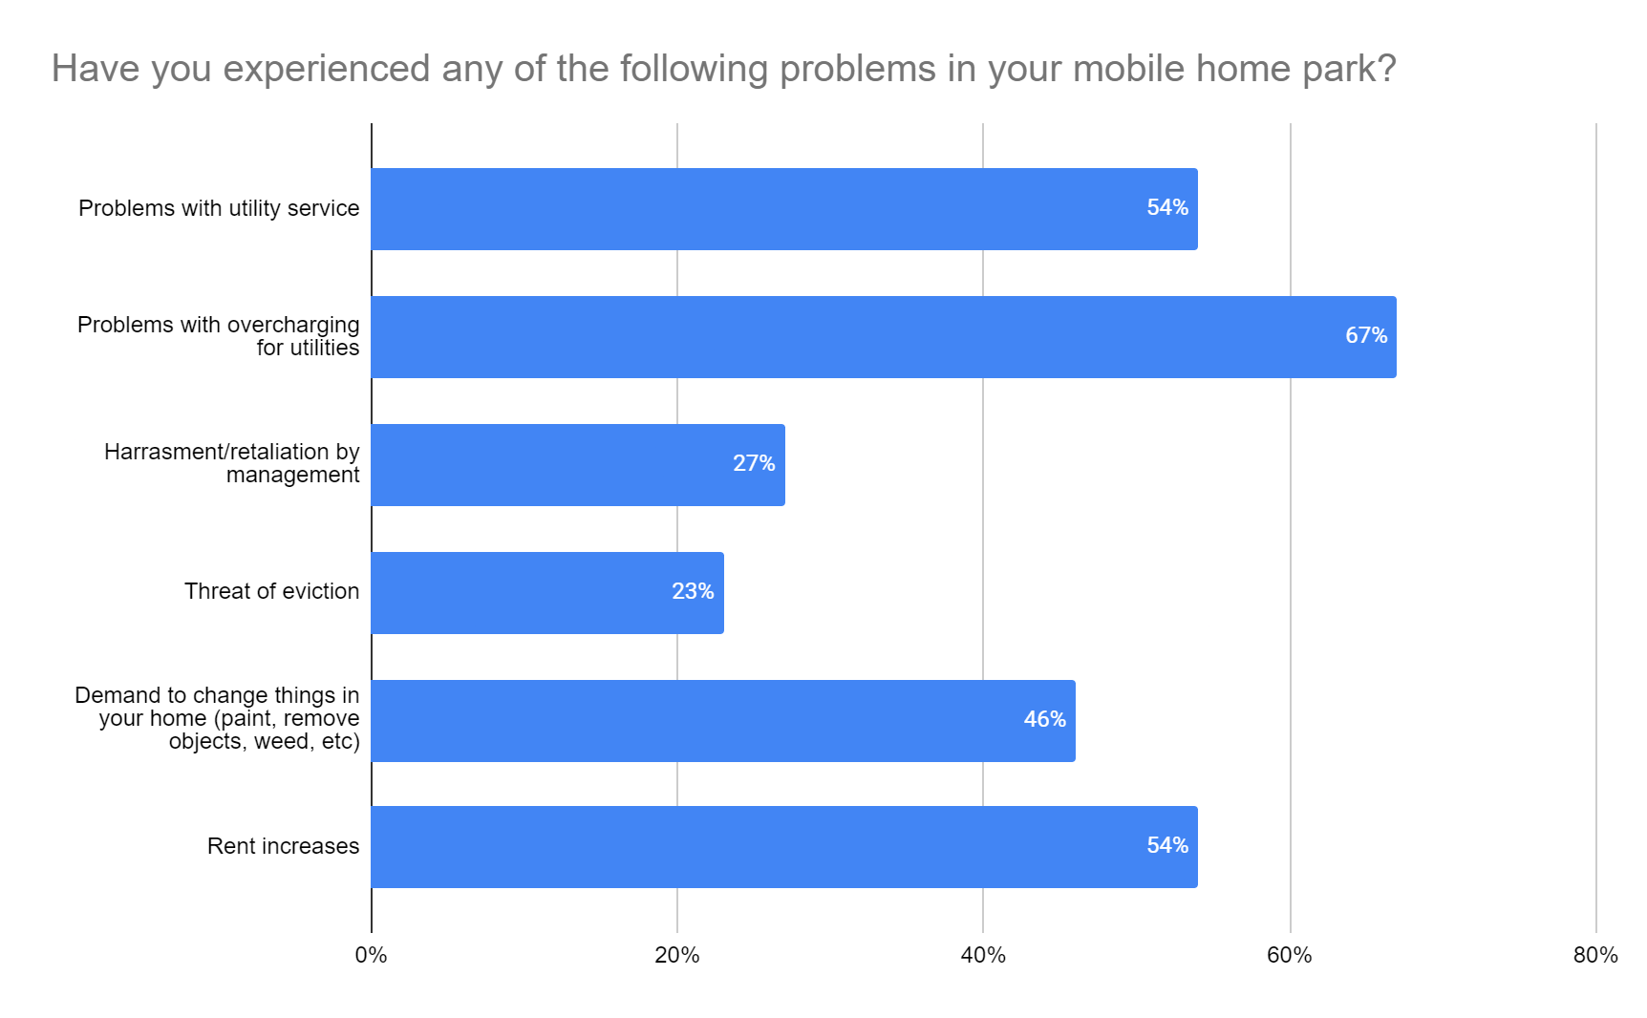

Slide 9
Most Common Reported Problems
Problems with overcharging for utilities (67%)
Problems with reliability of utility service (54%)
Rent increases (54%)

Slide 10
Examples of Utility Overcharging in Tucson (Ward 3, County District 3
Flowing Wells Garden: Residents signed a petition mostly focused on utility charges (mostly electricity). Some as high as $1200. Others $900, $600, $800, $400. About 75% of park have reported high charges. About 57 units occupied. The electric bill for a snowbird who was not in the home that month had an electric bill of $300 for a month when no one in the home.

Slide 11
Examples of Utility Overcharging in Tucson (Ward 3, County District 3
In another park, Desert Shores, owned by the same company as Flowing Wells Garden, residents report:
One person reported monthly electricity bills up to $399 a month for a small single-wide trailer
Another person in the same park reported a water bill of $250 for a single month for a small mobile home with no outside irrigation
A third person in that park reported high gas bills despite not having any gas appliances connected. This person was subsequently evicted for not paying the disputed bill.

Slide 12
Examples of Utility Overcharging in Tucson (County District 2)
In a park in Unincorporated Pima County (District 2), a family of 4 in a single-wide trailer with no exterior irrigation had water bills ranging from $300 to $826. The family has checked for leaks multiple times (turning off all of the water and seeing if the meter moved) but the high bills continue.
When they called Tucson Water, they were told they could not help because it is the park that is the customer, not the family.

Slide 13
Examples of Utility Overcharging in Tucson
The burden of proof should not be on the residents to prove that they are being overcharged. People are being evicted over false charges, some of whom may then lose the home that they own, all over fraudulent or excessive charges.

Slide 14
Potential Solutions
Implement Clear System for Utility Charging Accountability
Expand Weatherization Programs
Expand Assistance to Master Meter Customers
Support Conversion to Direct Customers

Slide 15
1. Implement Clear System for Utility Charging Accountability
Arizona Law (ARS 33.1413.01) prohibits exploitative utility charges, including:
Requiring there be a separate meter for each utility user if utilities are billed separately from lot rent
Requiring that the costs of charges only with the meter reading amount and dates be stated on bill
Prohibiting the landlord from charging “more than the prevailing basic service single family residential rate charged by the serving utility or provider.”

Slide 16
But enforcement is extremely burdensome for the tenant!
These existing laws, if property enforced, could significantly protect many utility users on master meters, the legal recourse generally requires the tenant to take their landlord to court if there is a dispute over utility charges.
We need better enforcement mechanisms and more accountability that do not require residents to bear so much logistical burden.

Slide 17
2. Expand Weatherization Programs
Some of the issue with high utility costs are related to historically weak energy standards in mobile homes and manufactured housing. Of the more than 50,000 units of manufactured housing in Pima County, 35% are pre-1976 mobile homes. These older homes from before HUD standards were put in place are often poorly insulated and have much higher cost to heat and cool per square foot than new manufactured homes or most site built homes.

Slide 18
Expand Weatherization Programs (cont)
This inefficiency in heating and cooling has costs far beyond high utility bills. MH residents in Arizona are 8 times more likely to die from heat-related causes than those in site built homes.
In 2023, 40% of indoor heat related deaths occurred within MH and RVs.

Slide 19
Expand Weatherization Programs (cont)
Weatherization programs exist, but are not funded at anywhere near the level needed to meet the actual need. We need significant expansion of such programs.
The City of Tucson Housing and Community Development has already taken the lead in applying for the HUD PRICE Grant, which would greatly expand weatherization, including whole home replacement for select pre-1976 homes. More is still needed, especially if this proposal is not funded.

Slide 20
3. Expand Low Income Discounts to Master Meter Parks
Major utilities, including Tucson Water and TEP, offer low-income discounts and conservation rebates, but many of these programs are not available for people who live in mobile home parks who have a master meter.
Not available for
Master-Meter customers

Slide 21
Tucson Water: Mobile Home Park Billing
According to Tucson Water, there are 100 mobile home parks in the Tucson Water Service Area that are billed at the Mobile Home Park rate.
These parks have a master meter, so the park itself is considered the customer, not the end user (other parks in the area that have individual utility owned meters are not included on the list)
Legally, the park can charge up to the “prevailing basic service single family residential rate charged by the serving utility or provider” (ARS 33-1413.01)

Slide 22
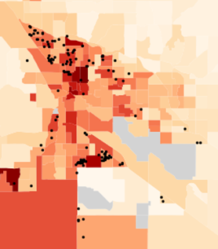
Yet if these mobile home park customers were being charged the “prevailing single family residential rate,” they may be paying up to significantly less with the low-income discount.
As illustrated in map to the right, the majority of mobile home parks are in areas of high concentrations of poverty.
(darker colors indicate the poverty rate by Census tract. Black dots represent mobile home parks from TEP. We do not yet have Tucson Water data, but likely to have significant overlap).

Slide 23
Expand Assistance to Master Meter Customers
One potential step is to expand low-income assistance and utility rebates to master meter end users.
Southwest Gas has already done so. On their Arizona Low Income Ratepayer Assistance (LIRA) website they include a link to the Master-Meter Tenant application

Slide 24
Expand Assistance to Master Meter Customers (cont)
California Public Utility Code requires utility companies to include master meter customers in utility assistance. The assistance is distributed to the master meter account, who is required to apply that amount to the eligible household’s bill. (Application here)

Slide 25
Text of California Public Utility Code:
https://california.public.law/codes/ca_pub_util_code_section_739.5
"Notwithstanding any other provision of law or decision of the commission, the commission shall not deny eligibility for the California Alternative Rates for Energy (CARE) program, created pursuant to Section 739.1, for a residential user of gas or electric service who is a submetered resident or tenant served by a master-meter customer on the basis that some residential units in the master-meter customer’s mobilehome park, apartment building, or similar residential complex do not receive gas or electric service through a submetered system."

Slide 26
4. Support Conversion to Direct Customers
When people are direct customers of a utility (have utility company provided meter at their home), they have all the rights and responsibilities of all other utility direct customers and can apply for low-income assistance and rebates through standard processes. It also eliminates the opportunity for overcharging by park owners. Many mobile home parks do have individual meters for each home.
Arizona Administrative Code already prohibits Master Meters in new mobile home parks or expansions of existing parks.

Slide 27
Support Conversion to Direct Customers (cont)
Example: Mobilehome Park Utility Upgrade Program of California Public Utilities Commission
Pilot program that began in 2015 to voluntarily move master-meter / submeter service to direct utility service for natural gas and/or electrical service. Funded by the utility company at no cost to the mobile home park or its residents.
Because they were already customers, service deposit is waived.

Slide 28
As this issue is deeply affecting housing affordability in the City of Tucson, I propose that the Commission on Equitable Housing and Development form a working group to focus on studying the issues affecting mobile home parks and manufactured housing communities and to make recommendations to Mayor and Council to remedy problems of affordability in parks.

