Slide 1
August 6, 2026
Community Ordinances & Development Enhancements CODE Tucson ’26 Updates
Commission on Equitable Housing & Development

Slide 2



CODE Tucson ‘26
Initiated by the Mayor and Council on December 16, 2025
Modernize development codes for clarity, efficiency, usability
  Improve processes
  Support high-quality review and development
Stakeholders shared their ideas through surveys
Mayor and Council consideration targeted for Fall 2026
Guided by existing policies and outreach conducted for 2023 code update package
Notes:
Community and City staff stakeholders

Slide 3
2026 Initial Community Survey
Community members asked what changes they would like to see to the Unified Development Code
Survey open from December 22, 2025 - February 25, 2026
Questions based on level of experience with the code (no experience, occasional users, frequent users)
159 responses received
  63 with no experience
  67 occasional users
  29 frequent users
Broad array of responses received, but many centered around increased infill, parking standards, neighborhood preservation, and improving review processes

Slide 4
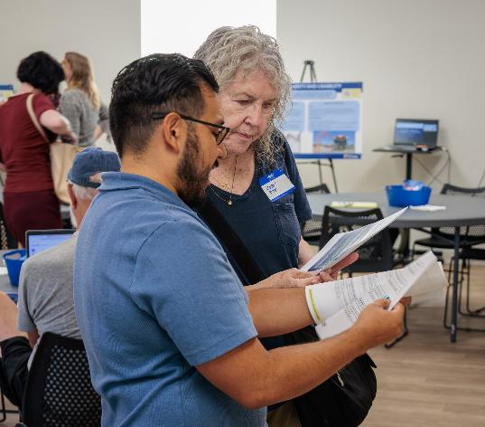
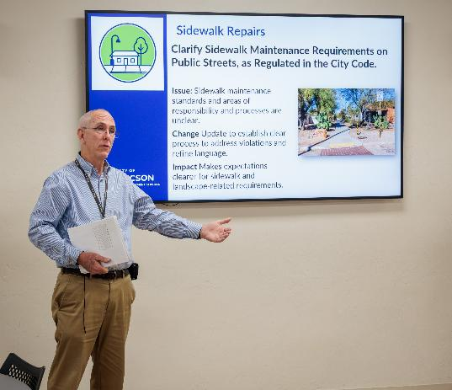
Community Engagement Meetings
Two community meetings held to introduce and gather feedback on the proposed code changes
  June 1, 2026 evening in person
  June 8, 2026 daytime virtual
Total of 58 public participants between two meetings, with 39 at the first meeting, and 19 at the second
Comments received included those related to process changes, the need to remove barriers to housing, and parking standards
A follow up community survey was provided to allow for additional feedback

Slide 5
Follow-Up Community Survey
Community survey open from June 1 to July 8
Received 47 responses, which emphasized:
  Remove Barriers to Housing – simplify codes and address housing affordability
  Reform Parking Standards – Reduce or remove parking minimums and add flexibility for modern development patterns
  Streamline Permitting Processes – Simplify workflows that add complexity and time to development review process
  Clarify Code Language – Reduce confusion and improve clarity of the code
  Update Design Standards – Continue to create flexibility for ADU’s middle housing, and adaptive reuse

Slide 6
Themes for Code Updates
Notes:
Currently a list of approximately 75 changes

Slide 7
Theme | Number of Items | Focus
Clarify Parking Standards | 3 | Simplify parking requirements to better align with how sites are used today.
Code Clarity and Usability | 12 | Clean-up items that improve wording, organization, consistency, and ease of use.
Emerging Land Uses & Adaptive Reuse | 13 | Respond to newer land uses, changing business models, and reuse of existing buildings.
Modernize Design Standards | 7 | Update design-related standards to reflect current practices, technologies, and development needs.
Remove Barriers to Housing | 2 | Support housing flexibility and reduce avoidable regulatory barriers.
Sidewalk Repair | 1 | Clarify sidewalk requirements on public streets, as regulated in the City Code.
Sign Code Reauthorization | 11 | Update sign standards to improve organization, interpretation, and use. Remove sunset date.
Simplify Review Processes | 11 | Administrative or procedural changes intended to make reviews more clear, predictable, efficient and reflective of current practices.
Notes:
Based on current list, reviewing an additional 15 or so changes based on survey feedback and continued staff review.

Slide 8
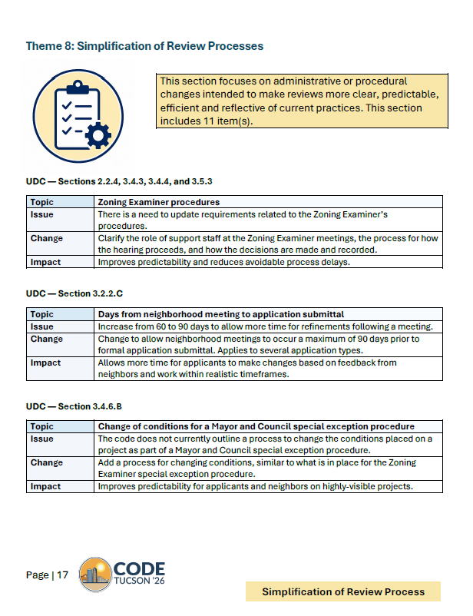
More Information on Proposed Changes
Detailed information on the proposed code changes are available on the CODE Tucson ‘26 Project Website, Including:
CODE Tucson ‘26 Info Packet
Information Posters
Draft Redline Amendments
  https://www.tucsonaz.gov/Departments/Planning-Development-Services/Planning-Initiatives/CODE-Tucson-26

Slide 9

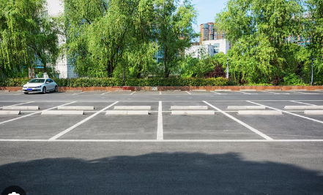
Clarify Parking Standards
Simplify parking requirements to better align with how sites are used today.
Parking calculations for mixed use developments
Parking for recreational uses
Parking for self-service uses without staff

Slide 10
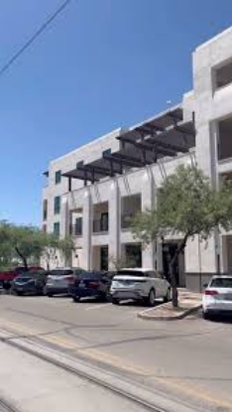
Example: Parking Calculations for Mixed Use Developments
Issue: Mixed-use developments must calculate parking separately for entertainment, food service, and alcohol service.
Change: Remove the separate parking calculation requirement for mixed-use developments so that all building area is calculated the same.
Impact: Lowers parking requirements, removes a development barrier, and reduces unnecessary parking.

Slide 11

Code Clarity and Usability
Clean-up items that improve wording, organization, consistency, and ease of use.
Clearer Terms and Definitions
Updated References and Responsibilities
Process and Administrative Requirements
Technical Corrections

Slide 12

Emerging Land Uses and Adaptive Reuse
Respond to newer land uses, changing business models, and reuse of existing buildings.
Adaptive Reuse and Nonconforming Uses
New or Evolving Use Categories
Accessory and Mixed Uses
Services in Commercial, Office, and Industrial Areas

Slide 13

Modernize Design Standards
Update design-related standards to reflect current practices, technologies, and development needs.
Height Standards for Small and Accessory Structures
Setbacks Placement and Site Layout
Wall Heights
Use-Specific Design Standards
State Law Alignment

Slide 14
Example: Update Noise Regulations to Align with State Law
Issue: Existing noise regulations do not align with Arizona Senate Bill 1182 which establishes earlier construction start times during summer months to reduce impacts of extreme heat on workers.
Change: The change allows an earlier summer start time and establishes a more consistent winter construction start time, as follows:
  Summer (April 1-October 31) – 5am (4am concrete pouring)
  Winter (November 1-March 31) – 7am
  Saturdays – 7am
  Sundays and Legal Holidays – 9am (personal residence only)
Impact: Creates alignment with state law and allows for earlier construction during cooler hours.

Slide 15

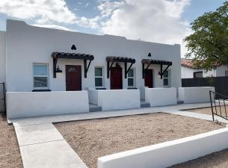
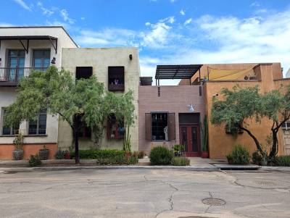
Remove Barriers to Housing
Support housing flexibility and reduce avoidable regulatory barriers
Subdivision Standards for Middle Housing & Middle Housing Clarifications
Setback Requirements for Accessory Structure Conversions

Slide 16
Example: Subdivision Standards for Middle Housing
Issue Update subdivision standards to address density changes brought about by middle housing.
Change Create regulations that allow property owners where residential development of 1-4 units is allowed to divide their land.
Impact Supports more flexible housing options, including smaller and more affordable home ownership opportunities and aid in middle housing implementation.

Slide 17


Sign Code Reauthorization
Reauthorize and Remove sunset date. Update sign standards to improve organization, interpretation, and use.
Code Authorization and Review Process
Electronic and Technical Compliance
Measurement and Calculation Standards
Sign Types and Use-Specific Signage
Location Setbacks and Sign Form

Slide 18

Simplification of Review Process
Administrative or procedural changes intended to make reviews more clear, predictable, efficient and reflective of current practices.
Hearing and Decision Procedures
Timing and Public Notice Requirements
Utility and Infrastructure Review
Minor Historic Review
Minor Site Improvements
Development Process Clean-Up

Slide 19
Example: Flexible Lot Development (FLD) Process Clean-Up
Issue To be in alignment with state law, revise the requirement for compliance with general and other plans. The neighborhood meeting requirement is not in alignment with other processes.
Change Clarify that proposed FLDs that are part of a rezoning must comply with all relevant plans. Removed requirement for a neighborhood meeting and instead require mailed notice of an application submittal, consistent with the Community Corridors Tool public process.
Impact Improves predictability and reduce avoidable process delays.

Slide 20
Example: Ordinance Adoption Procedure for Rezoning
Issue The existing ordinance adoption procedure was adopted before development packages (DP's) were required. As a result, it includes an extra step for authorization by the Mayor and Council.
Change Remove the Mayor and Council authorization process – rezoning requests would be approved by Mayor and Council via ordinance.
Impact Streamlines the process and helps reduce avoidable process delays.

Slide 21
Code Update Tentative Timeline
Request for Mayor and Council Initiation
Community Engagement and Input
Draft Code Amendment
Planning Commission Review and Public Hearing
Mayor and Council Public Hearing and Consideration
December 2025
January - July 2026
June 2026
August - September
2026 (Tentative)
October 2026 (Tentative)
Notes:
August 12 tentative, go through all of the comments, and see if there is anything additional to add.

Slide 22
Additional Information
Planning Commission Study Session August 26, 2026
Project website https://www.tucsonaz.gov/Departments/Planning-Development-Services/Planning-Initiatives/CODE-Tucson-26
For questions, or further comments, please email:
  Carver: Carver.Struve@tucsonaz.gov
  Cesar: Cesar.Acosta2@tucsonaz.gov

Slide 23
Administrative Manual Update

Slide 24
Administrative Manual Update
Effective June 15
Simplify submittal and content requirements for development packages and final plats
Enact HB 2447 (administrative approval of final plats) and SB 1353 (review timelines for single-family residential permits)
Next steps:
  Notification and publication on PDSD website
  Staff use of new checklists
  Additional updates later this year as part of CODE Tucson ‘26
Notes:
CODE Changes mostly related to language clarifications and application submittal requirements.

Slide 25
Middle Housing Design Competition

Slide 26

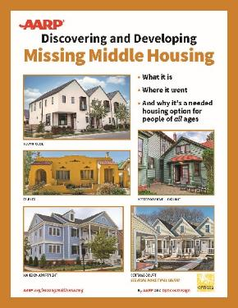
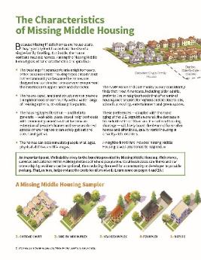



PDSD has received AARP funding to support the Middle Housing Design Competition and expand the Casita Model Plan Library from 2023.
Local designers submit middle housing designs
Up to 15 designs will be selected to be awarded $1000, and fees waived for building permit review and approval of the residential model plan based on construction documents
Official competition launch is July 9, 2026; closes in September
Submitted plans will be evaluated by a committee
A public survey will be held in October, which will also factor into the determination of winners
Winners announced and prizes distributed in October/November
Selected Model Plans will be displayed in the online gallery
Tucsonans use the library to contact designers and purchase plans for use
Notes:
This grant allows us to reach out to our community to get designs that are reflective of the various benefits of an ADU and our unique Tucson aesthetics. *include the benefits of having a model plan library
Share link to ABCs of ADUs: https://www.aarp.org/livable-communities/housing/info-2023/slideshow-abcs-of-adus.html#:~:text=The%20ABCs%20of%20ADUs%20is,visiting%20AARP.org%2FADUs.
Introduce Hal Bergsma – Representative from AARP and former planner

Slide 27
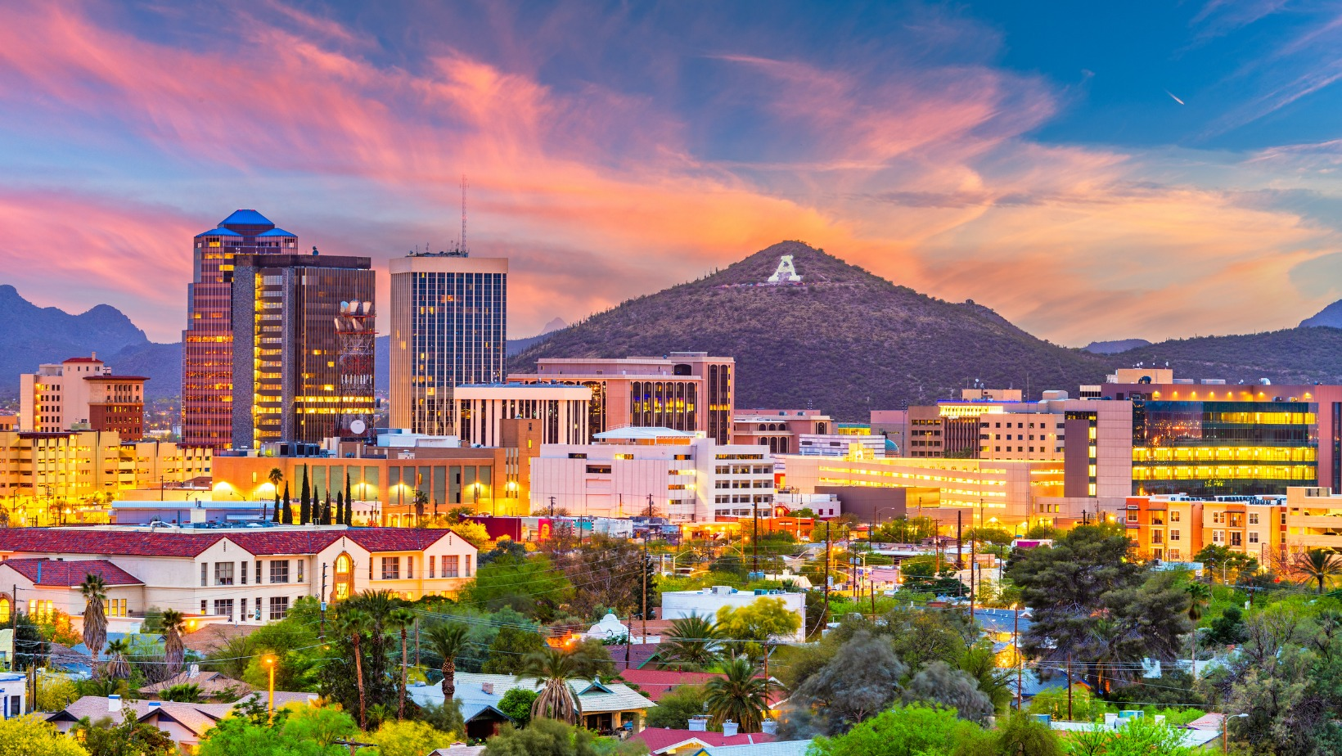

Questions

