Slide 1
CATEGORIES OF COMMENTS REGARDING THE DOWNTOWN MOTOR APARTMENTS
From October 28th meeting

Slide 2
CATEGORIES
PRESERVATION OF EXISTING BUILDING
LAND SWAP
BUILDING HEIGHT
SECTION 106 PROCESS (City Staff will respond)
SIZE/DESIGN OF PROPOSED APARTMENTS
SIZE/DESIGN OF PROPOSED BUILDING
RENTS/UTILITIES
PUBLIC OUTREACH
PARKING

Slide 3
PRESERVATION OF EXISTING BUILDING
LOSS OF HISTORIC CHARACTER
1. 1950s +/- The carports were enclosed. The motel rooms went from 19 to 29 units
2. Original rooms were designed as motel rooms attached to a carport
3. Original rooms and carports, which have been enclosed, have been converted into small apartments with small kitchenettes
4. Original Motel room sizes: 270 sf per room
5. Original Carports: 187 sf per carport
6. Original building: Motel rooms: 19 rooms, Carport spaces: 19 carports
7. Kitchenettes were added to small motel rooms and converted carports
8. Poor craftsmanship with the additions and interior remodeling

Slide 4
PRESERVATION OF EXISTING BUILDING (PG.2)
LOSS OF HISTORIC CHARACTER
9. Horizontal railing replaced with non code compliant Wrought Iron vertical railing
10. Addition to the lobby. New construction to the Lobby was built on the City’s sidewalk right-of-way
11. Flagstones were added to the 2 front building. This represented a lost of historic fabric
12. Removal of all Landscape Elements in the central drive
13. Roof damage over 40% of existing roofs
14. Water damage and mold on and in walls
15. Lead paint and asbestos abatement required
16. Fire and Structural damage at 2 story building
17. A substantial amount of historic fabric has been lost

Slide 5
LAND SWAP
Prohibited by Program Regulations
Not economically feasible for either City or Developer
Project as designed, where designed, is allowed by all local codes and ordinances
Strong community support for project as currently located

Slide 6
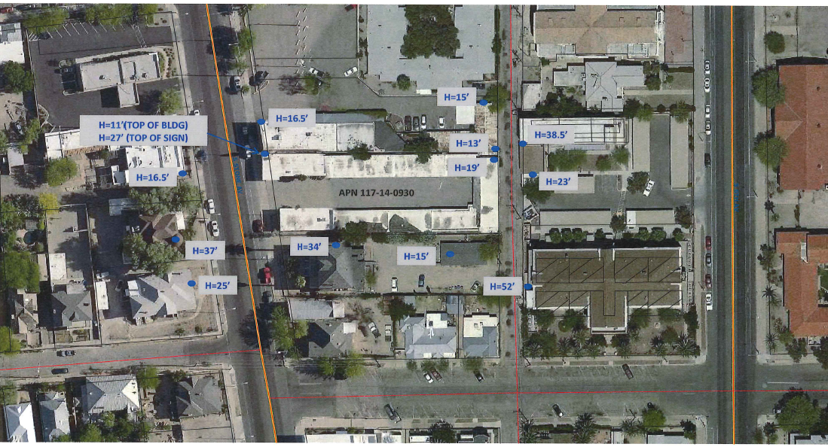
SURROUNDING BUILDING
HEIGHT CONTEXT

Slide 7
SIZE/DESIGN OF PROPOSED APARTMENTS
One (1) BR, one (1) BA units are 692 gsf
Two (2) BR, one (1) BA units are 856 gsf

Slide 8
2 BR 2BA Plan (856 SF)

Slide 9
1 BR 1 BA Plan (692 SF)

Slide 10
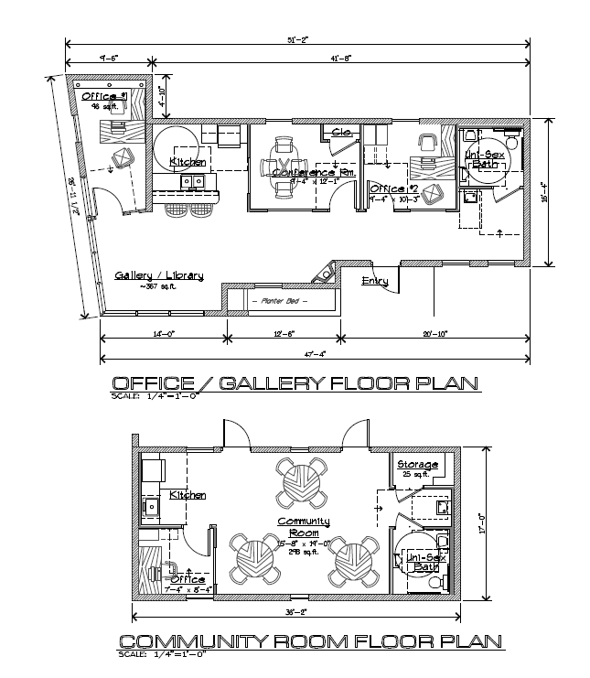
Community and Office Space

Slide 11
SIZE/DESIGN OF
PROPOSED BUILDING
Within allowable side-yard setback limits (5’; 0’ allowed)
Within allowable height limits (could build to 75’)
Within allowable density limits
Building has been stepped back from original design
Roof line has changed from hip roof to parapet
Building has been moved in from property lines
Overhanging balconies were removed from front
Additional articulation added to rear of building
Rear yard setback increases from 0’ to 20’
Proposal incorporates reuse of existing front buildings and project sign

Slide 12
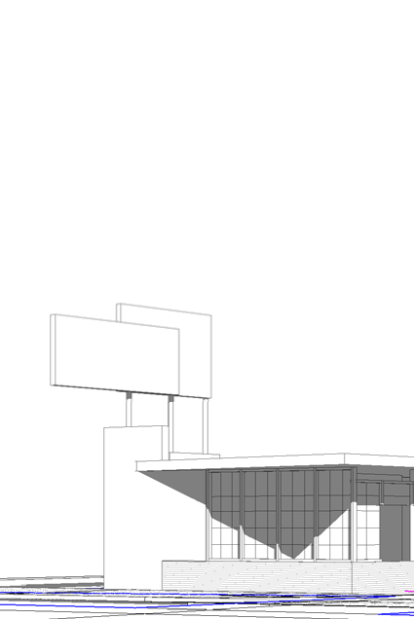
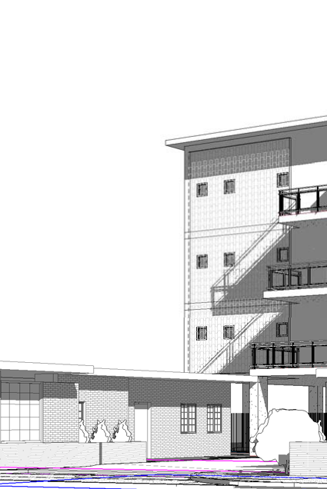
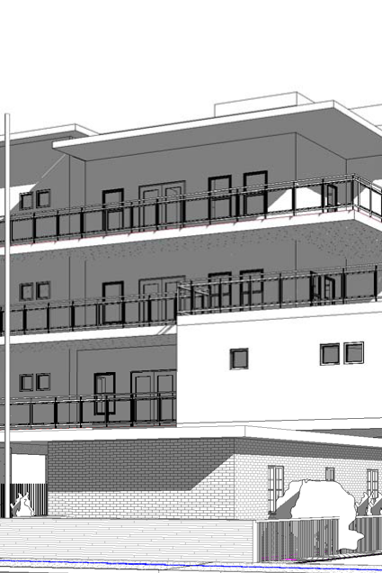
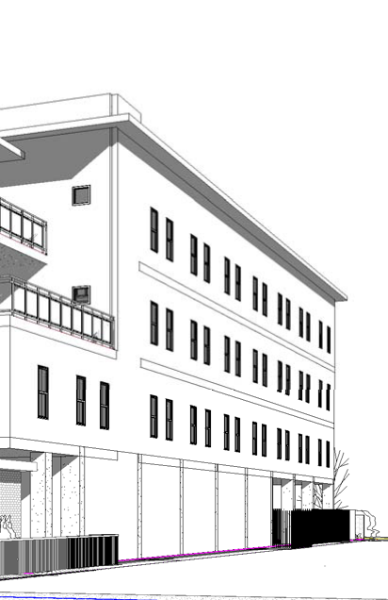
Initial proposed design
View from stone avenue

Slide 13
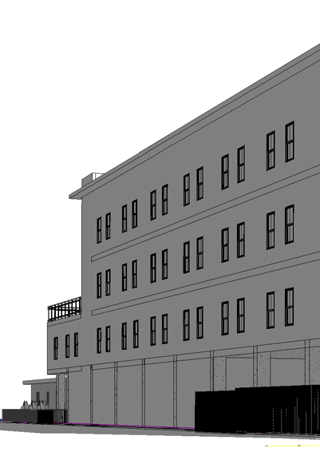
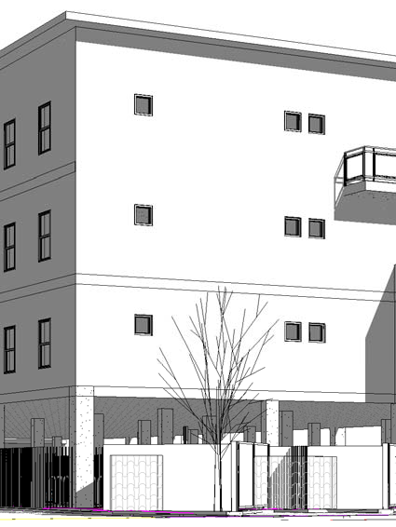
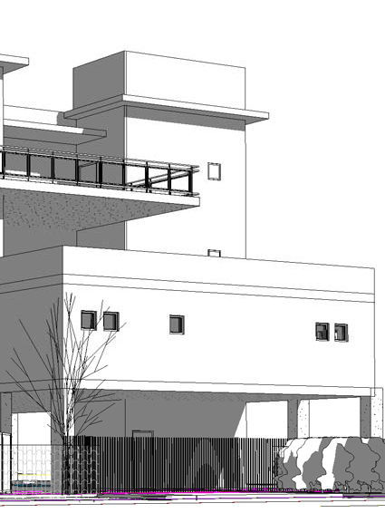
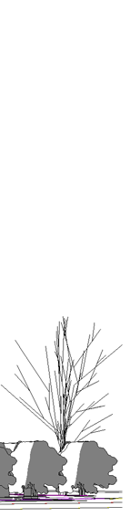
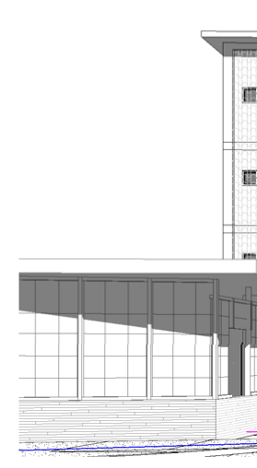
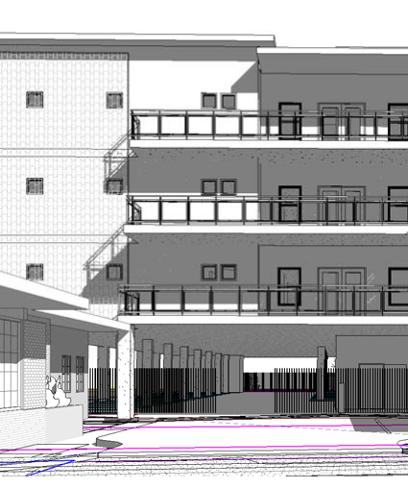
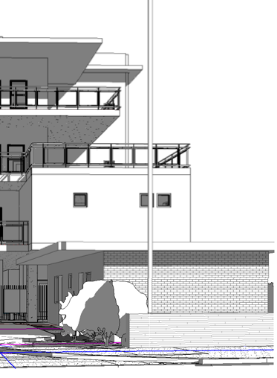
Initial Proposed Design
Perspective from Russell Avenue
Perspective from Stone Avenue

Slide 14
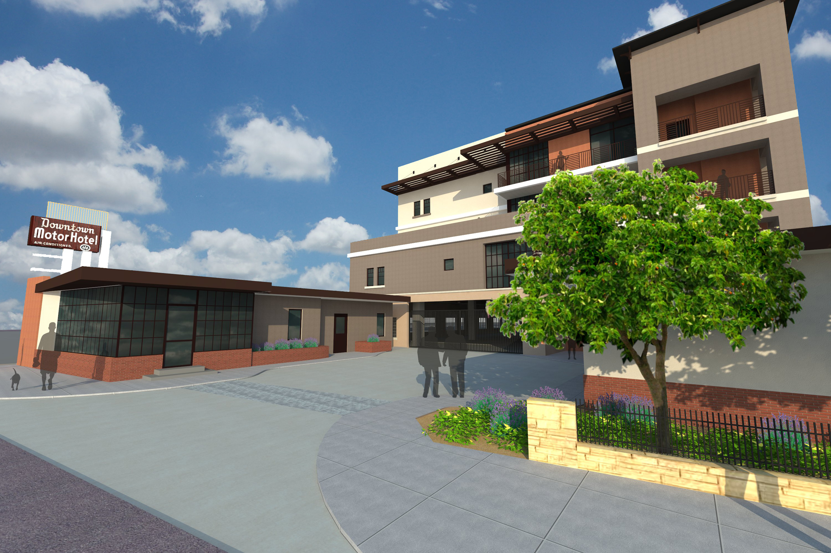
Revised Building Elevation

Slide 15
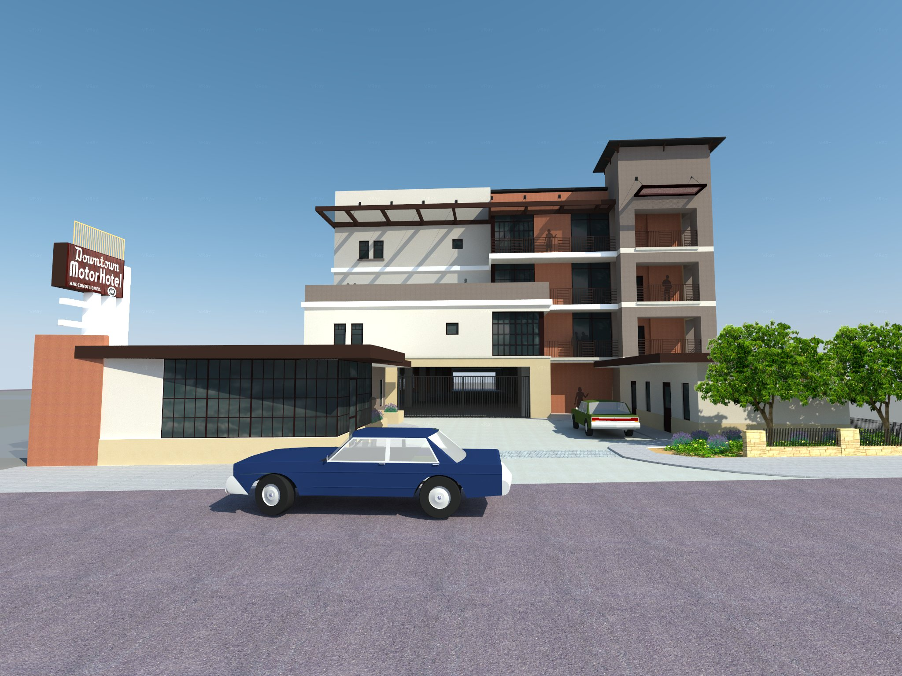

Slide 16
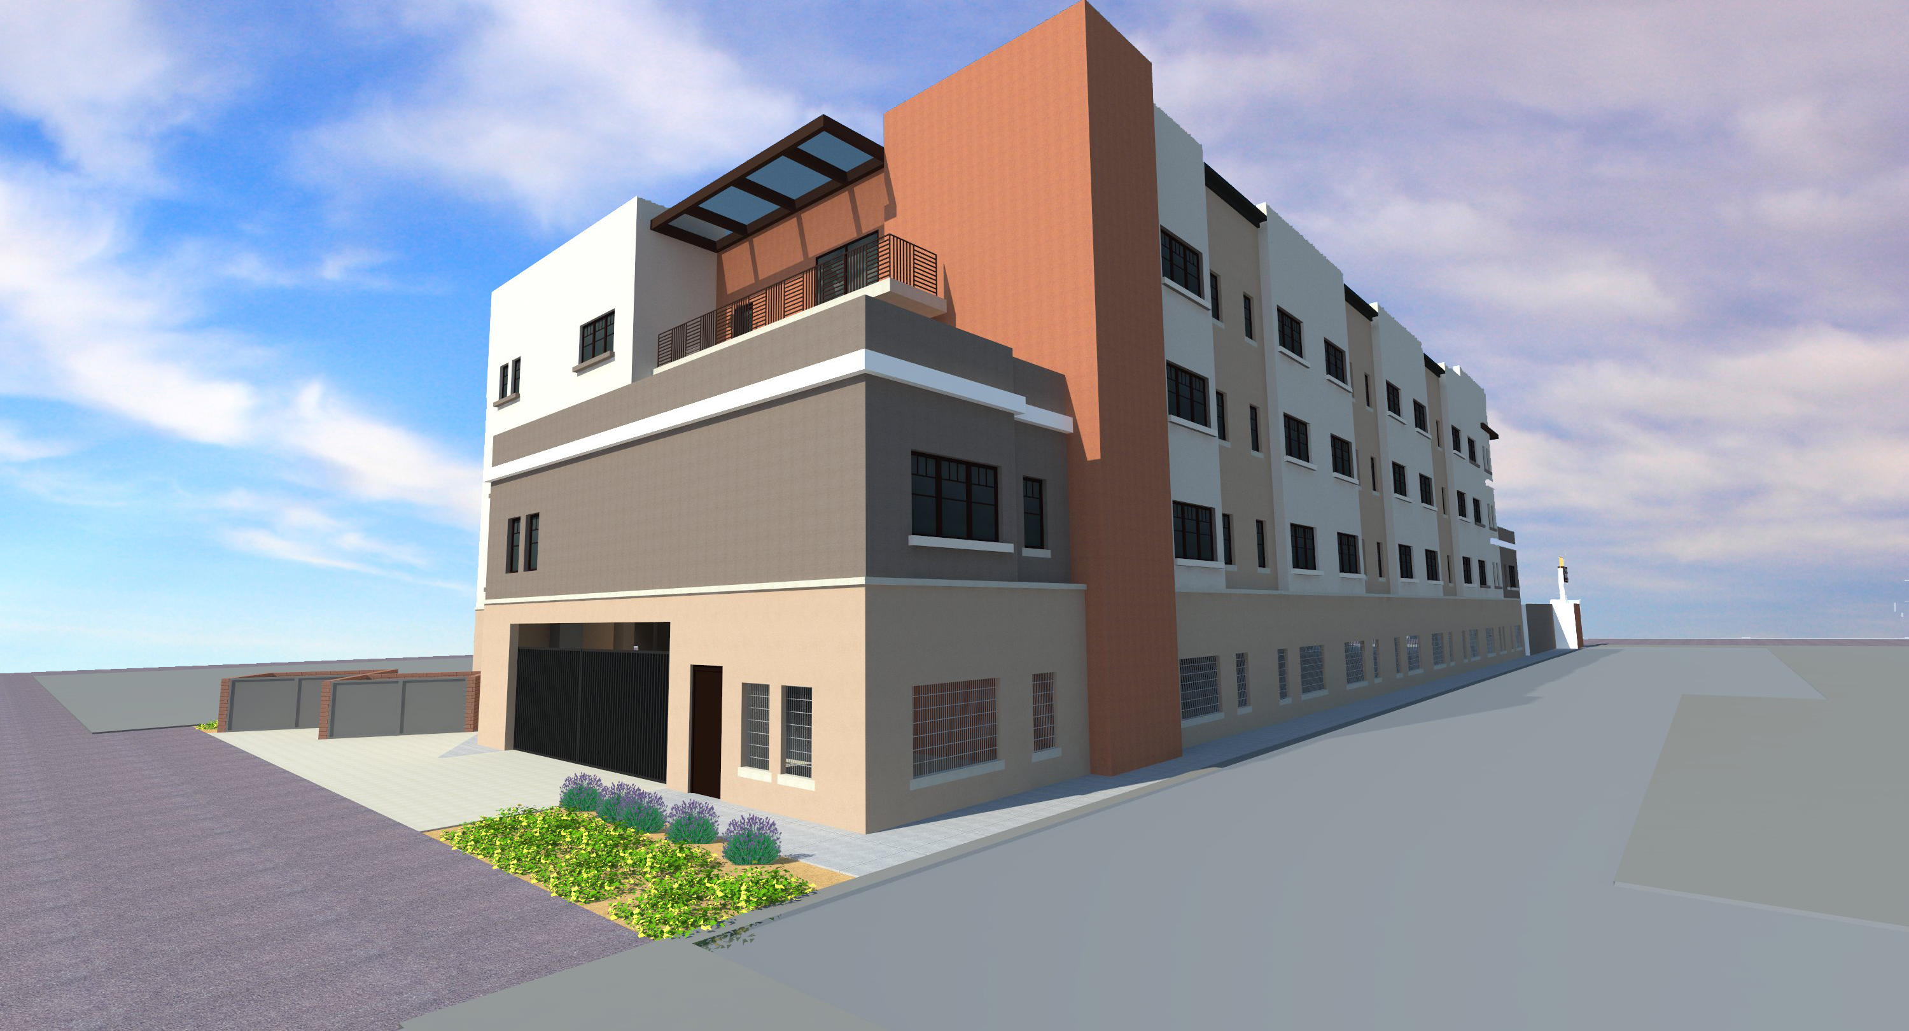
Revised Building Elevation

Slide 17
RENTS AND UTILITIES
Rents are affordable to households with incomes at or below 60% of Area Median Income, depending upon household size
Affordable housing is in critical short supply, especially near the downtown core of Tucson
  RENTS INCLUDE ALL UTILITIES

Slide 18
PARKING
Project is located in the Downtown In-Fill Incentive District
City of Tucson approved an Individual Parking Plan
Parking needs have been studied and adequate, secure parking has been provided under the podium and is hidden from street view

Slide 19
Public Outreach
All required public meetings were attended; all required notifications were made; no rezoning was initiated; project is not in an HPZ; the following meetings were Courtesy Public Meetings and not required by City of Tucson:
January 17, 2014 Courtesy neighborhood meeting with representatives of the Historic Committee from Armory Park and Ward 6 on site
April 11, 2014 Courtesy Presentation to Office of Integrated Planning, Armory Park Neighborhood Association, Council Member Steve Kozachik, and other interested citizens
August 6th, 2014 Courtesy Public Presentation at Ward 6 Office
October 7th, 2014 Courtesy Public Meeting to present design changes

Slide 20
DMA - Incorporated Public Comments
Roof style was changed from peaked to flat - lowering overall building height
Stepped-back the west elevation for architectural interest, diversity, and scale
Windows were changed from horizontal sliders to Low-E single-hung design
Balconies were re-designed and reduced to eliminate elements projecting
over existing building 1-story structures
Added articulation to building elevations for architectural interest, diversity, and
scale

Slide 21
DMA - Incorporated Public Comments
Building materials will vary for architectural interest, diversity, and scale
Color palette to reflect existing Stone Avenue aesthetic
Added pocket landscaping at Stone Avenue frontage and to the interior of the site to enhance resident experience
Repair and refurbish the existing two 1-story buildings that will remain
Repair and keep existing Downtown Motor Hotel sign

Slide 22
SUMMARY
THE DOWNTOWN MOTOR APARTMENTS IS A WELL CONCEIVED, AFFORDABLE MULTI-FAMILY HOUSING DEVELOPMENT NEAR THE DOWNTOWN CORE DEVEVOPED BY TWO EXPERIENCED FIRMS, COMPASS AFFORDABLE HOUSING AND BETHEL DEVELOPMENT, INC.
THE DOWNTOWN MOTOR APARTMENTS HAS A BROAD BASE OF COMMUNITY SUPPORT EVIDENCED BY THE NUMBER OF POSITIVE LETTERS AND COMMENTS RECEIVED
DOWNTOWN MOTOR APARTMENTS LOOKS FORWARD TO BEING A POSITIVE INFLUENCE IN THE NEIGHBORHOOD AND WORKING CLOSELY WITH ALL ITS NEIGHBORS TO INSURE THE VERY BEST OUTCOME FOR ALL

